Slide 1
BSBMED301 Interpret and apply medical terminology appropriately
Session 4 Movement and Directional Terms
Notes:
Cover

Slide 2
Introduction to movement and directional terms
To be able to specify the location of pain, injury, disease or surgical incisions it is important to have good knowledge of the anatomical positions, body regions and related movement and directional terminology

Slide 3
Anatomical Terms

Slide 4
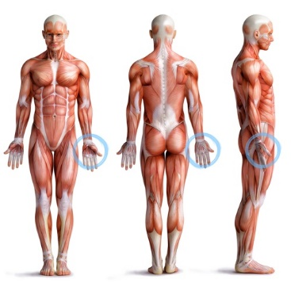
Anatomical position
The anatomical position is the reference system that all medical professionals and texts use when describing body components
The anatomical position involves:
Standing upright
Arms at the side
Palms facing forward
Head erect
Eyes looking forward

Slide 5
Anatomical Position
Anatomical position also refers to a selection of terms that refer to the position of organs and tissues within the body.
It is the reference system which medical professionals and medical texts use when describing components of the body.
Also it is useful to indicate the position of injury, pain and a surgical procedure.

Slide 6
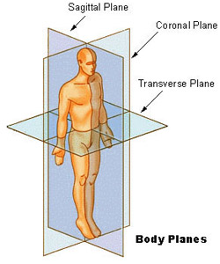
Body Planes
The imaginary planes which divide the body into sections:
Sagittal/median plane: divides the body into right and left
Coronal/fontal plane: divides the body into anterior (frontal) and posterior (back)
Transverse plane: divides the body into superior and inferior parts.

Slide 7
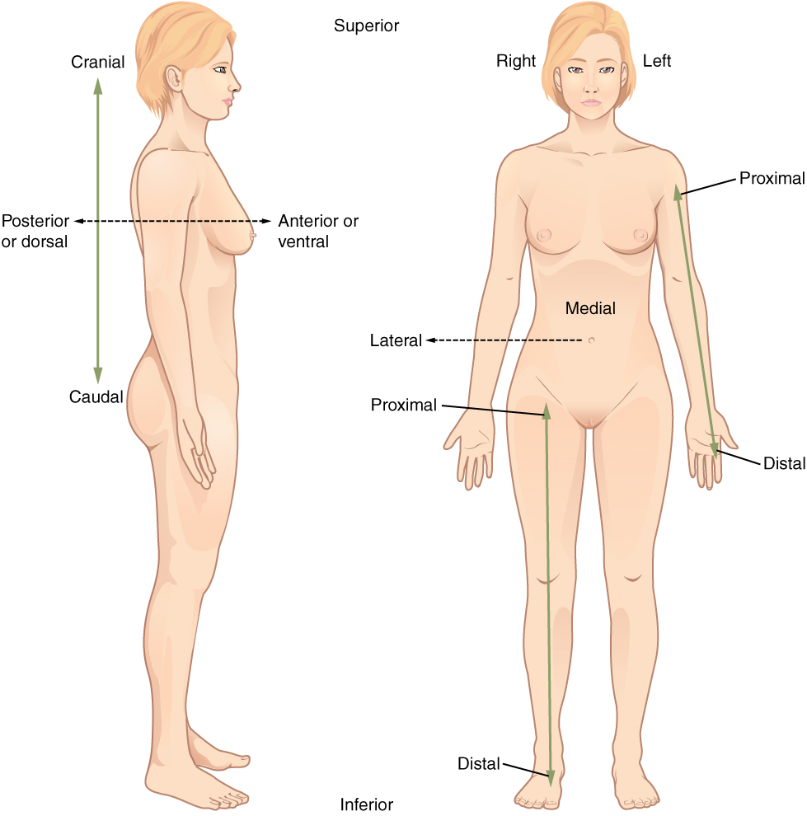
Directional terminology
Using the anatomical position and the midline (transverse plane) as our guide, you can start to use terminology indication the location and direction parts of the body are located compared to other parts.

Slide 8
Directional terminology
Directional term | Meaning | Example
Medial | Towards the median or midline | The eyes are medial to the ears
Lateral | Away from the median or midline | The ears are lateral to the nose
Superior | Upper, towards the head | The head is superior to the pelvis
Inferior | Lower, away from the head | The neck is inferior to the head
Anterior (Ventral) | Related to the front of the body | The lips are anterior to the teeth
Posterior (Dorsal) | Related to the back of the body | The teeth are posterior to the lips
Proximal | Located near the point of attachment or origin | The shoulder is proximal to the elbow
Distal | Located further from the point of attachment or origin | The ankle is distal to the knee
Proximal and distal can only be used if it relates to one and the same body part, ie. a leg or arm. You cannot state that the hips are distal to the chest; the hips are located inferior to the chest.
Superficial | Closer to the surface of the body | The skin is superficial to the muscle
Deep | Away from the surface of the body | The stomach is deep to the skin
Supine | Lying face upwards, on the back
Prone | Lying face down, on the stomach
Ipsilateral | Located on the same side of the body | The left arm and leg are ipsilateral
Contralateral | Located on opposite sides of the body | The left arm is contralateral to the right arm
Intermediate | Located between two structures | The knee is between the hip and ankle

Slide 9
Activity
If a person is lying in the lateral position would they be on their side or back?
The toes are distal or proximal to the chest?
The index finger is peripheral or central on the hand?
Is the mouth superior or inferior to the eyes?
Is the spine medial or lateral to the shoulder?
Is the buttock posterior/anterior to the abdomen?

Slide 10
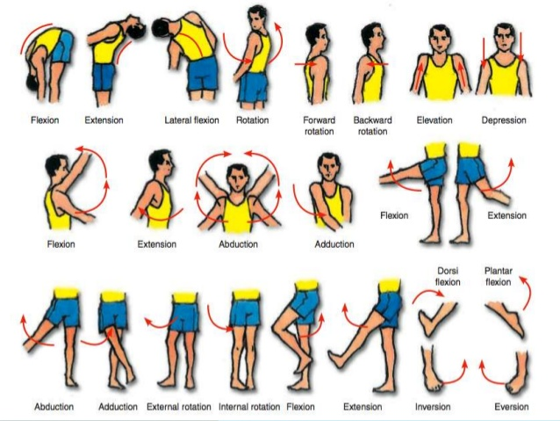
Movement Terminology
Movement in the body occurs in relation to the body planes shown earlier
Movement terminology is important to use to ensure accurate communication of movements that are consistant across all healthcare workers. This also clear understanding for all staff and are able to be interpreted regardless of patient positioning (sitting/standing/lying down)

Slide 11
Movement Terminology
Joint movements in the sagittal plane:
Flexion | The angle between segments decreases, for example bending the arm at the elbow, or bending the leg at the knee
Extension | The angle between segments increases, for example straightening the arm at the elbow, or straightening the leg at the knee
Dorsiflexion | Bring the toes in the direction of the shin and up (dorsi- means back)
Plantar flexion | Pointing the toes away from the shin and down
Joint movements in the frontal plane:
Abduction | Movement away from the midline (ab- means away from)
Adduction | Movement toward the midline (ad- means to)
Elevation (shoulder) | Moving the shoulder girdle in a superior (upward) direction
Depression (shoulder) | Moving the shoulder girdle in an inferior (downward) direction
Valgus (at the knees) | Legs in a ‘knocked-kneed’ position
Varus (at the knees) | Legs in a ‘bow-legged’ position
Inversion (foot) | Lifting the medial (inside) border of the foot up
Eversion (foot) | Lifting the lateral (outside) border of the foot up (e- means out from)
Radial deviation | Moving the hand, leading with the thumb, towards the radius
Ulnar deviation | Moving the hand, leading with the little finger, towards the ulna
Lateral flexion (trunk) | Bending the trunk to either the left or right side

Slide 12
Movement Terminology
Joint movements in the transverse plane:
Medial rotation | Inward or internal rotation
Lateral rotation | Outward or external rotation
Supination (forearm) | With elbow held at 90° the palm of the hand rotates up
Pronation (forearm) | With elbow held at 90° the palm of the hand rotates down
Horizontal abduction | In a horizontal position the body part moves away from the midline
Horizontal adduction | In a horizontal position the body part moves toward the midline
Protraction | Body part is moved forward, such as the shoulder or jaw
Retraction | Body part is moved backward, such as the shoulder or jaw

Slide 13
Directional Terminology

Slide 14
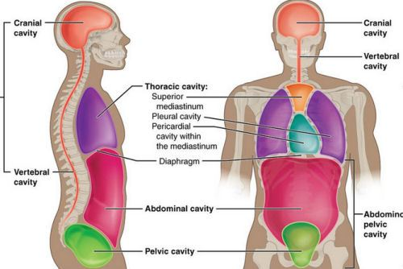
Body Cavities
The body in an anatomical position can be divided into the:
Cranial
Spinal (vertebral)
Thoracic
Abdominal
Pelvic

Slide 15
Cranial and Spinal Cavities
Cranial cavity
The brain
The skull
Meninges
Cranial nerves
Cerebrospinal fluid
Spinal cavity:
Extension of the cranial cavity
Consists of the vertebral column

Slide 16
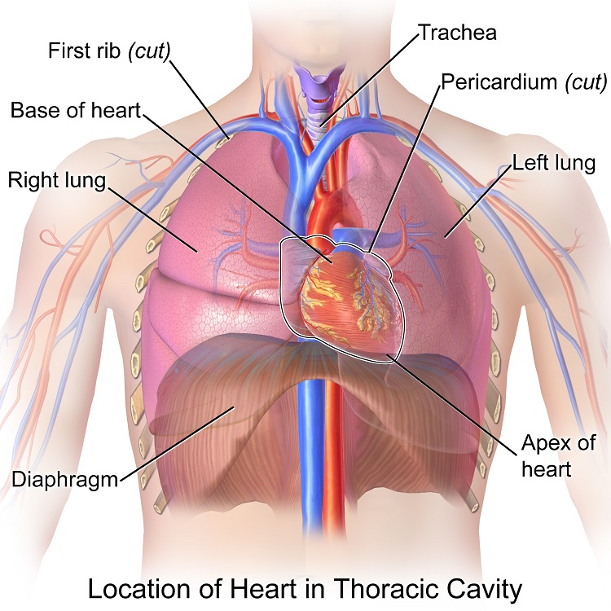
Thoracic Cavity
The cavity consists of
Heart
Lungs
Ribs
Trachea
Diaphragm

Slide 17
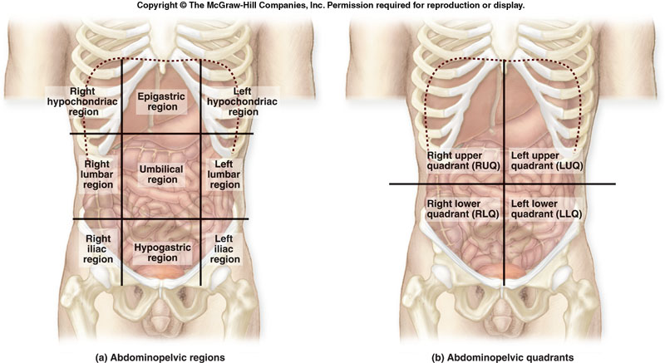
Abdominal Cavity
Major organs of this cavity:
Stomach
Liver
Gallbladder
Spleen
Pancreas
Kidneys
Adrenal glands
Large intestine
Small intestine

Slide 18
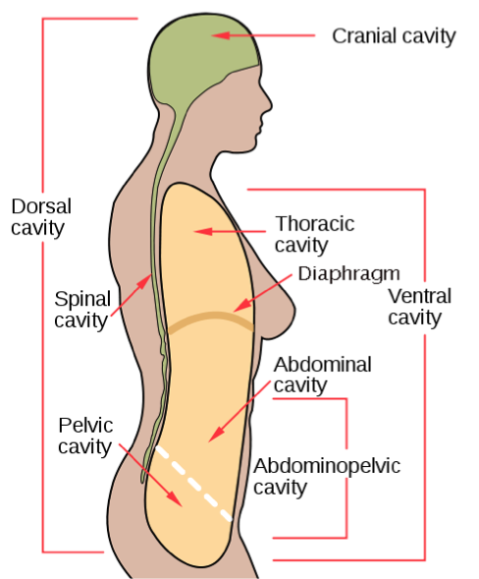
Pelvic Cavity
Major organs of this cavity:
reproductive organs
urinary bladder
Colon
rectum.

