Slide 1
BSBMED301 Interpret and apply medical terminology appropriately
Session 3 Abbreviations + 24 Hour Clock
Notes:
Cover

Slide 2
Abbreviations
Abbreviations and symbols are commonly used as a form of shorthand in medical terminology.
These can be used by many professions such as medical receptions & administration staff, doctors, nurses, allied health professionals, insurance companies and even barristers and solicitors.
You cannot be expected to remember all abbreviations; however, overtime you will become familiar with them.
It is a good idea to practice them for fluency.

Slide 3
Abbreviation, Acronyms and Symbols
Used commonly in health care environments to assist staff in speaking and writing more efficiently
Accuracy in there meaning to avoid mistakes
Acronyms may have different meaning in different areas (e.g. department, clinic, etc) and even countries, so caution is needed.
Note: Should always consult your workplace policy for a list of approved abbreviations, acronyms and symbols

Slide 4
Acronyms
Is a type of abbreviation
Contains initial letter or groups of letters in a phrase or groups of words
The shortened word forms a producible word of its own
e.g. ANZAC (Australian and New Zealand Army Crops)
NOF (Neck of Femur)
AIDS (acquired immunodeficiency syndrome)

Slide 5
Initialism
Is a type of abbreviation
An acronym that is not pronounced as a word, but where the abbreviation is pronounced through its individuals' letters is classed as an initialism
GP - General Practitioner
HSA – Health Services Assistant
BP – Blood Pressure
HIV - Human immunodeficiency virus

Slide 6
Latin acronyms
Like how most medical terminology is derived from Latin and Greek. So are many acronyms, particularly in relation medication orders, which has been standardised by the Australian Commission Safety and Quality in Healthcare
PO – Oral
PRN – When required (Pro re nata)
Stat – Immediately (Statim)

Slide 7
Use of abbreviations in healthcare
The table below shows some common abbreviations. Notice the face that these examples have more than one meaning, depending on the profession or healthcare area that is using the abbreviation.
This shows importance of ensuring you understand meaning of the abbreviation within the area and organisation you are working within
BF – Both Feet (podiatery)/ Breast Feeding (Nursing)
CT – Computer Tomography (radiology) / Cerebral Tumour (neurology
LLL - Left lower lobe (respiratory) / Left lower limb/ Left lower lid (eye)
RA – Right Atrium (cardiology) / Rheumatoid Arthritis

Slide 8
Accuracy of Abbreviation use
Always ensure you have used the correct abbreviations as the addition or omission of one letter will provide a completely different meaning than originally intended.
URTI – Upper Respiratory Tract Infection
UTI – Urinary Tract Infection
SOBOE – Shortness of Breath of Exertion/exercise
SOB – Shortness of Breath (can imply SOB all times)

Slide 9
Activity
Students are to name the Health Professionals who match the acronyms below
GP PT
OT SP
EN NP
SW EP
RN

Slide 10
Abbreviations
Abbreviations are also used to spell commonly used words
This is used to save time in completing documentation requirements and ensure consistency of communication across the healthcare service
These can either be a shortening of a word, or use of letters to correspond to the relevant word
Ortho – Orthopaedics BP – Blood Pressure
Chol – Cholesterol Dx – Diagnosis
Esp – Especially P - Pulse
Hx – History Wt - Weight
pt – patient HR – Heart Rate

Slide 11
Activity
Students are to fine the meaning of the abbreviations listed below
Students may wish to use resources (glossary) to assist
Try not to Google the answers
IV HTN
NG GI
CXR DOB
Bd DOA
PO ADL

Slide 12
Symbols
A symbol is a mark or character used as a conventional representation of an object, function, word or process. Symbols in health are used in written documentation as well as graphic symbols or signage in health organisations.
↑ = high, increase | +ve or + = Positive | 1/7 = 1 day
↓= low, decrease | -ve or - = negative | ♂ or M = male
# = Fracture | 1/52 = 1 week | ♀ or F = female
< = less than | 1/24 = 1 hour | ? = query
> = greater than | 1/12 = 1 month

Slide 13
Time and Frequency Abbreviations
Time abbreviation with numbers can often be confusing, see last example in the below table. When using number, do not use Roman numerals, such as ii for two
ac (Latin: ante cibum) before a meal TDS - three times/day
BD/bd – Twice a day QID – four times/day
Mane – morning 1/7 – One Day
Nocte – Nighttime 1/52 – One week
pc - (Latin: post cibum) after meals 1/12 – One Month
PRN – when needed/as required
Stat – immediately
Care should be taken when using numbers as abbreviations as they can be easily misinterpreted, and confirmation should be sort of organisational guidelines for their usage

Slide 14
Abbreviations and Symbols
These are commonly used as a form of shorthand in medical industry
These can be used by many professionals such as
Administration staff
Hospitals, Doctors, nurses & allied health professionals, laboratory staff
Pharmacy related prescriptions and over the counter products
Insurance companies
Barristers and solicitors

Slide 15
24 Hour Clock:
Are often used for
Patient appointments
Airlines companies
Railroads or transit companies
Armed Services

Slide 16
24 Hour Clock:
There are two main ways to show the time
”24 hour clock” or “AM/PM”
24 Hour Clock: the time is shown as how many hours and minutes since midnight.
AM/PM (or "12 Hour Clock"): the day is split into: the 12 Hours running from Midnight to Noon (the AM hours)
And 12 Hours running from Noon to Midnight (the PM hours)

Slide 17
Time – AM/PM
Normally the time is shown as
Hours : Minutes
Example
10:25 means 10 hours and 25 minutes

Slide 18
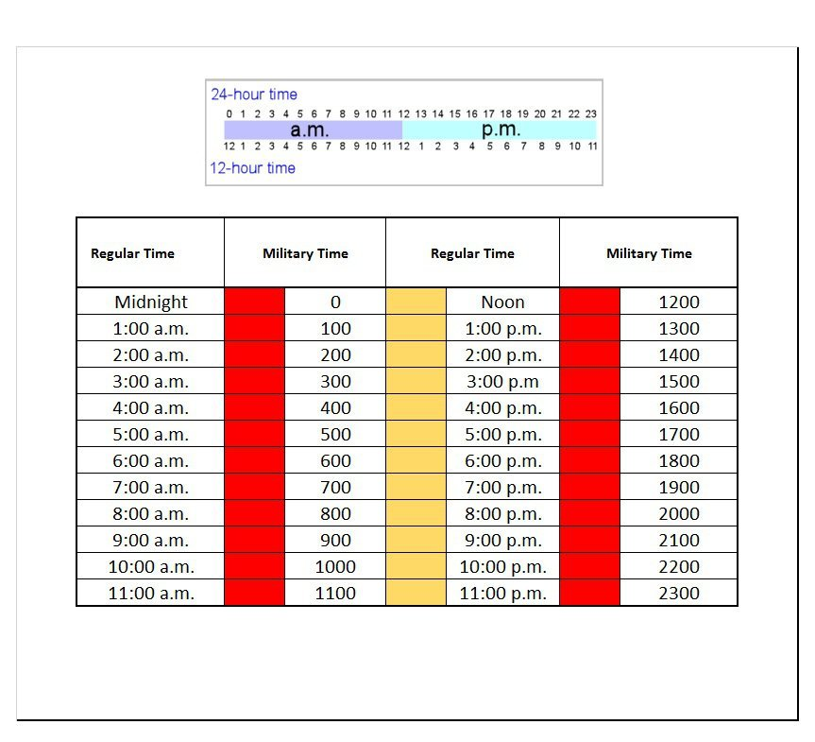

Slide 19
Decimal
Some organisations do not require you to use the decimal between hours (hh) & minutes (mm)
Example: Military 1342 (hhmm)
Other organisations such as hospitals operating theatres will require the use of decimal for purposes of Births or unforseen deaths on the operating table.
Example: 13:42:28 (hh:mm:ss)

Slide 20
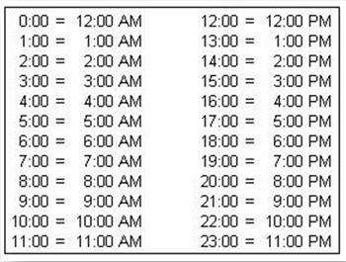
Sourced: http://french1byrd.wikispaces.com/file/view/24%20hour%20clock,%202012.PNG/386731566/448x340/24%20hour%20clock,%202012.PNG. (Accessed 04/01/25)

Slide 21
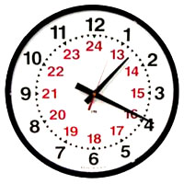
Sourced: http://chicagolighthouse.org/sites/default/files/u13/12-24_Hour_Clocks.jpg(accessed 04/01/25)

Slide 22
Activity
Convert the following times from 24hrs to AM/PM
1400hrs _________________
0700hrs _________________
2200hrs _________________

Slide 23
Activity
Convert the following times from AM/PM to 24 hours
7.30am ____________________
11.30pm ___________________
1.36pm ____________________

Slide 24
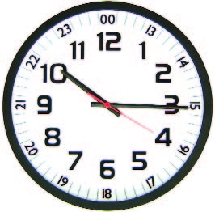
Activity
On the clock below, what time is shown in 24hrs?
Sourced: http://www.installer.com/photos/mfj-131rc.jpg (Accessed 02/01/2025)

Slide 25
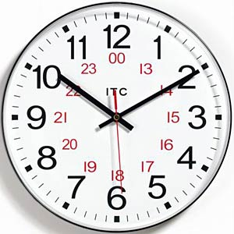
Activity
On the clock below, what time is shown in AM/PM?
Sourced: http://chasemarch.com/wp-content/uploads/2015/03/dual-clock.jpg (Accessed 2/1/2025)

Slide 26
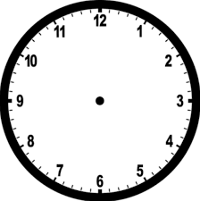

Slide 27
