Slide 1
BSBMED301 Interpret and apply medical terminology appropriately
Session 1 Basic Word parts
Notes:
Cover

Slide 2
Medical Terminology
For a healthcare worker, it is important to have a good understanding of and an ability to intepret medical terminology
The ability to read, pronounce correctly and understand a medical term is beneficial as it …
provides standardised communication between healthcare professionals
can assist in the avoidance of errors and misunderstandings in communication
can make documentation by healthcare professionals easier, especially when accepted medical abbreviations are used
can assist in more efficient and safe ongoing care of clients through avoidance of errors and misunderstandings

Slide 3
Activity – Medical Terminology
List as many occupations where medical terminology is used
List other types of workers or professions that would use medical terminology in their varying fields?
List the types of written documentation a healthcare worker/professional would use within their job role?
What routine tasks would health care workers/professionals carry out throughout the day using medical terminology?

Slide 4
Medical Terminology
5 basic word parts are used to make up medical words.
Some words include all five parts whilst others use only a few of them.
These are joined together to describe the meaning of the disease or illness.

Slide 5
These parts are called:
WORD ROOT (or ROOT WORD)
PREFIX
SUFFIX
COMBINING VOWEL
COMBINING FORM

Slide 6
WORD ROOT (or ROOT WORD)
basic foundation or building block of the medical term
PREFIX
Found at the beginning of the word
SUFFIX
Found at the end of the word
COMBINING VOWEL
may be needed between the root word and suffix to make the medical term easier to pronounce.
COMBINING FORM
vowel which is added to a root word

Slide 7
Reading the Medical Word
Read the meaning of medical terms from the suffix
then move to the beginning of the term and then into the middle.
See next slide – “Start to Read Here 1,2,3”

Slide 9
Word Root
A WORD ROOT or ROOT WORD is the basic foundation or building block of the medical term.
It is the main meaning of the word.
They usually, but not always, indicate:
the involved body part
may also indicate colour

Slide 10
Word Root
A root word cannot stand alone
May appear with a suffix, or between a prefix and suffix

Slide 11
Activity 1 Circle The WORD ROOT :
Erythrocyte | Haematology | Enteritis

Slide 12
Activity – 2 Complete the table below using your glossary
Word root | Body part | Example | Meaning
Gastr | Stomach | Gastritis | Inflammation of the stomach
Cardi |  | Cardiology
Pharynx |  | Pharyngeal | Relating to the throat or pharynx

Slide 13
Prefix
A PREFIX “pre” means to precede or come before and is always located at the beginning of a word.
It usually, but not always, indicates:
location
time
number
status

Slide 14
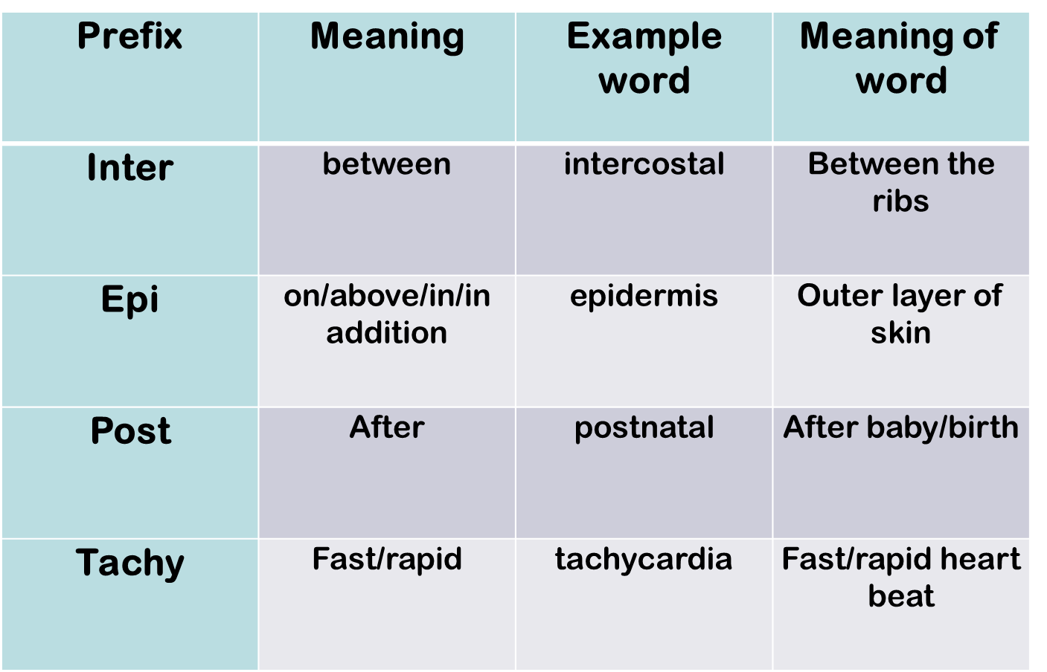

Slide 15
Activity – 3 Complete the table below using your glossary
Word root | Prefix | Prefix meaning
Epidural | Epi
Transgastric
Endodontic |  | In/inside

Slide 16
Suffix
The SUFFIX is the ending of the word and modifies or changes the meaning.
It usually, but not always indicates:
The procedure
condition
disorder
disease
specialists of that field

Slide 17
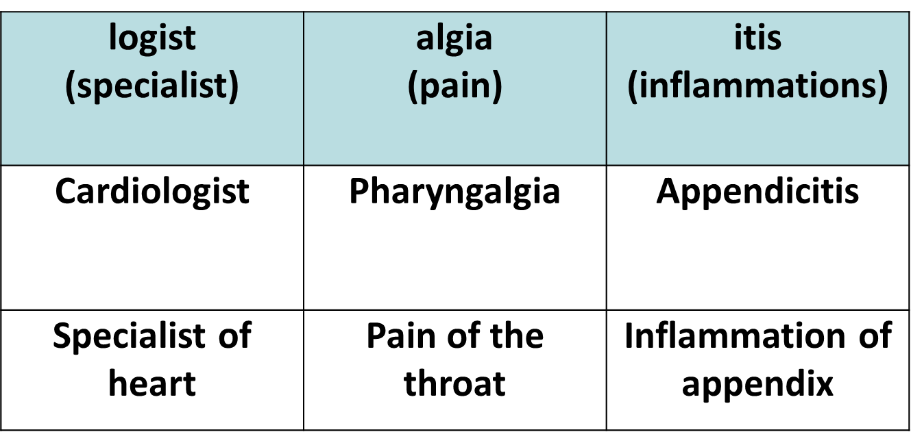

Slide 18
Activity – 4 Complete the table below using your glossary
Word | Suffix | Suffix meaning
Bronchoscopy | Scopy | Visual examination
Leukocyte | cyte
Mastectomy | ectomy

Slide 19
Suffix
There are a group of suffixes that all mean:
relating to
pertaining to
connected to/with
These are:
ac, al, ar, ary, ic, ive, ous

Slide 20
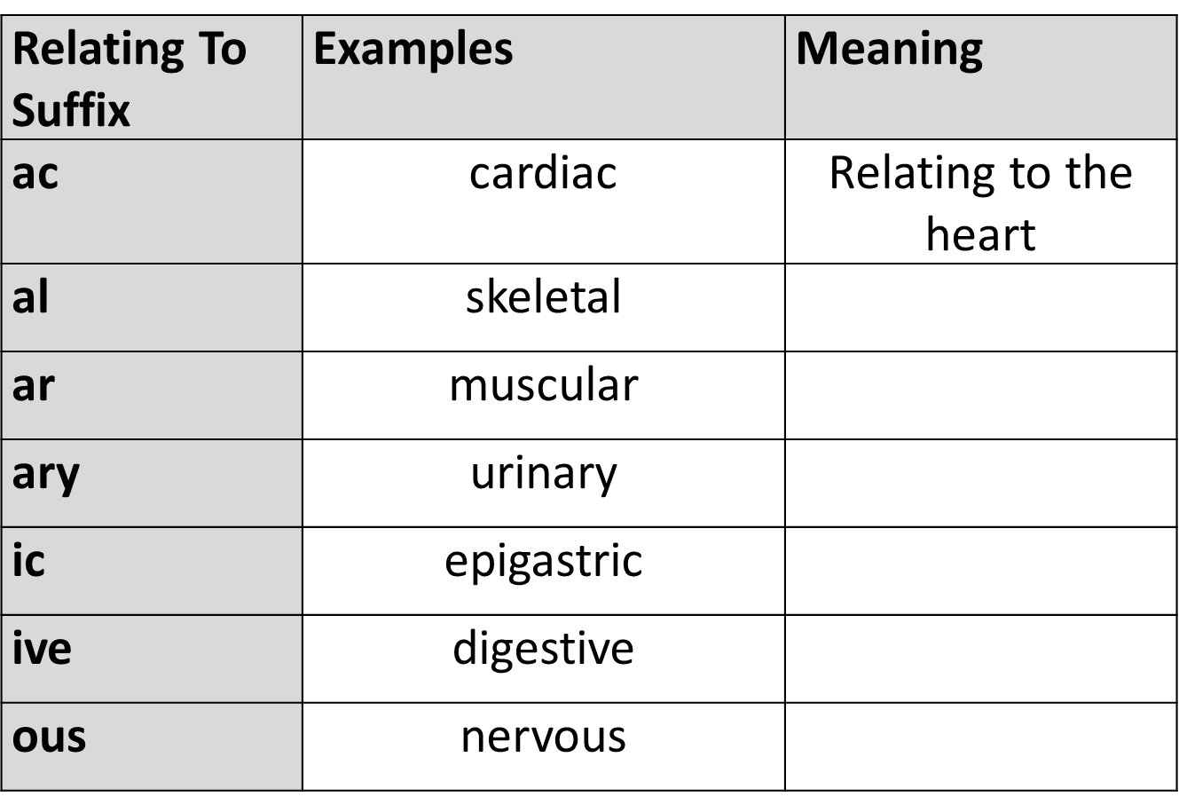
Activity – 5 Complete the table below using your glossary

Slide 21
COMBINING VOWELS
A, E, I, O, U
A combining vowel may be needed between the root word and suffix to make the medical term easier to pronounce.
The letter “O” is the most commonly used combining vowel.
Generally, “O” = and/of

Slide 22
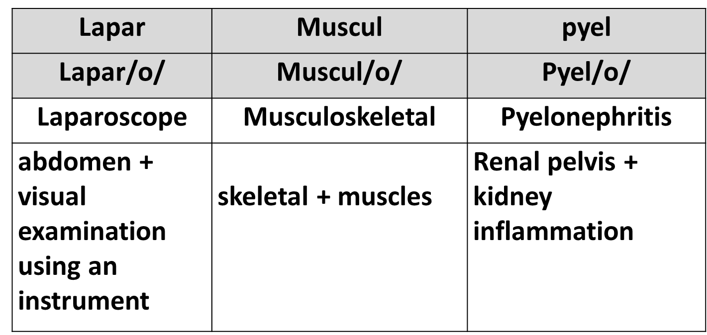
Vowels are A, E, I, O, U
A consonant is any other letter b, c, d, f, g

Slide 23
COMBINING FORM
The combining form is a vowel which is added to a root word
Example: GASTR/O

Slide 24
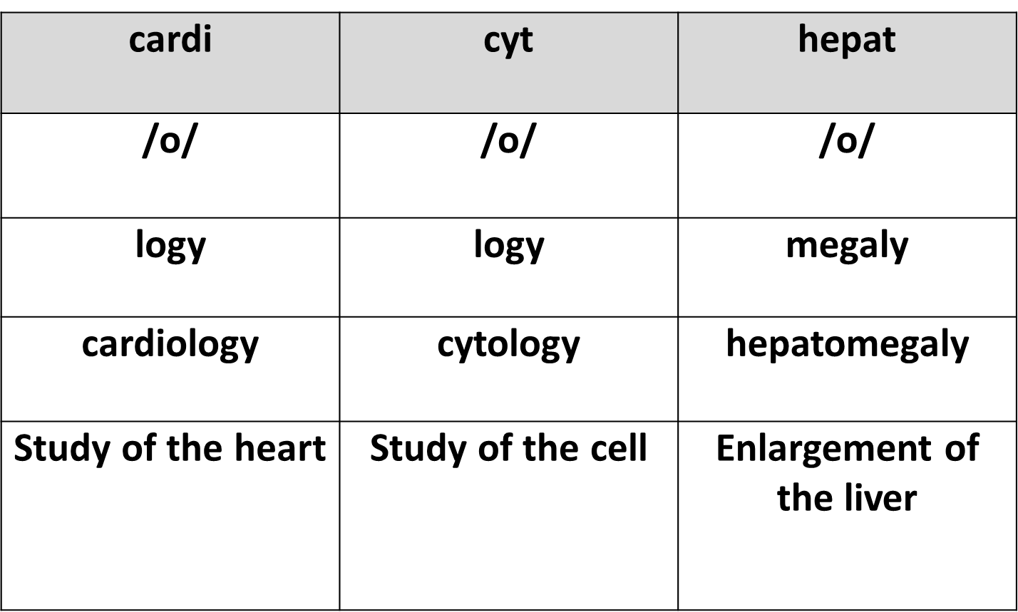
COMBINING FORM EXAMPLES

Slide 25
RULE
When a root word is shown with a Forward slash (/) and a combining vowel, such as GASTR/O, this format is referred to as a combining form.

Slide 26
Activity – 6 Complete the table below using your glossary
Bi | /o/
Enter | /o/
Gastr | /o/ | Gastro
Hepat | /o/
Arthr | /o/

Slide 27
Knowing the different word parts means you can put them together to create a word.
Not all words have a prefix or combining vowel but have at least one root word and a suffix.
For example: gastroenteritis

Slide 28
EPONYM: Are groups of words or phrases, describing medical conditions, structures or procedures or equipment that have been named by the first person who discovered or described it or invented it These cannot be broken down because they are derived from people’s names: Example: Alzheimer’s disease (1864-1915); Alois Alzheimer German Neurologist. What other EPONYM’s can you think of?

Slide 29
American (Harvard) V English (Oxford)
One of the major difficulties with spelling medical words is that there are two ways of spelling many words.
In Australia we tend to use the English version or commonly referred to as Oxford.
It is a good idea to make a list or perhaps memories the English versions as these will be the most common spellings you will come across throughout your career.
Be mindful when using computer software as it is general set in American dictionary format

Slide 30
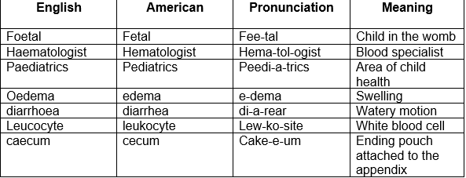
American (Harvard) V English (Oxford)

Slide 31
Revision of word parts
Root – gives the essential meaning of the term
Suffix is the word ending
Prefix is a small part added to the beginning of a term
Combining vowel connects roots to suffixes and roots to other roots usually be adding “O”
Combining form is the combination of the root and the combining vowel

Slide 32
Activity 7 - Which body parts are the following words referring to?
Rhinitis
Dematology
Trachea
Gastritis
Cardiology

Slide 33
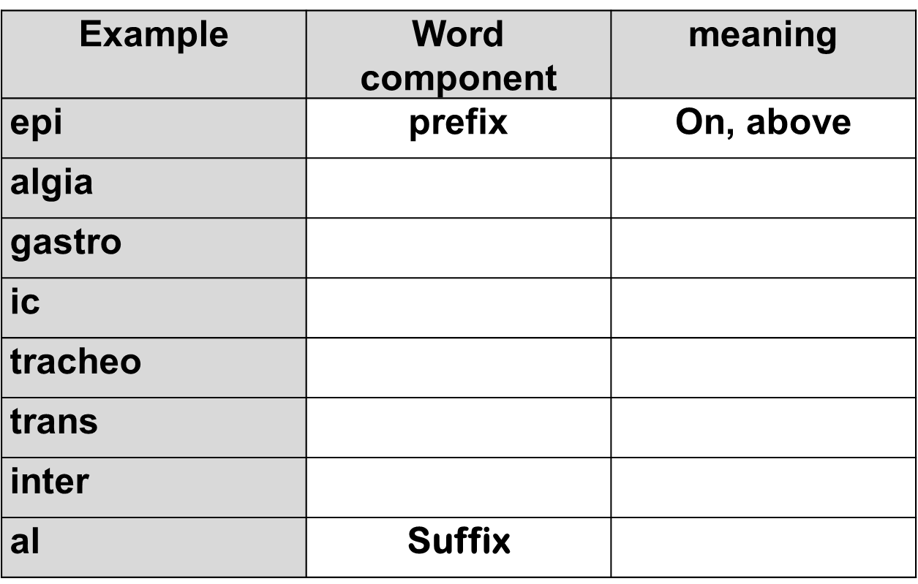
Activity 8 - Complete the table below by giving the Word Component & Meaning

Slide 34
IMPORTANT RULES
Read the meaning of the medical words from the suffix to the beginning of the word and then across to the middle.
Drop the combining vowel before a suffix that starts with a vowel.
Keep the combining vowel between word roots, even if the second root begins with a vowel.
Dropping vowels to join word parts

Slide 35
Dropping vowels to join word parts
Drop the combining vowel before a suffix that starts with a vowel
Keep the combining vowel between word roots, even if the second root begins with a vowel

Slide 36
This is to make the word easier to pronounce
Other example words:

Slide 37
Singular & Plurals
Like common words, most medical words are made into plurals by adding ‘s’ or by replacing ‘y’ with ies.
For example
One gastroscope becomes two gastroscopes
One hysterectomy becomes two hysterectomies
However, because there are many Latin words involved in medical terminology, there are a few unusual plural rules you need to be aware of.

Slide 38
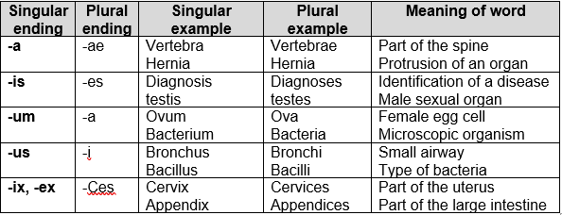
Singular & Plurals

Slide 39
Activity – 9 Match two combining forms with a suffix to make a word

Slide 40
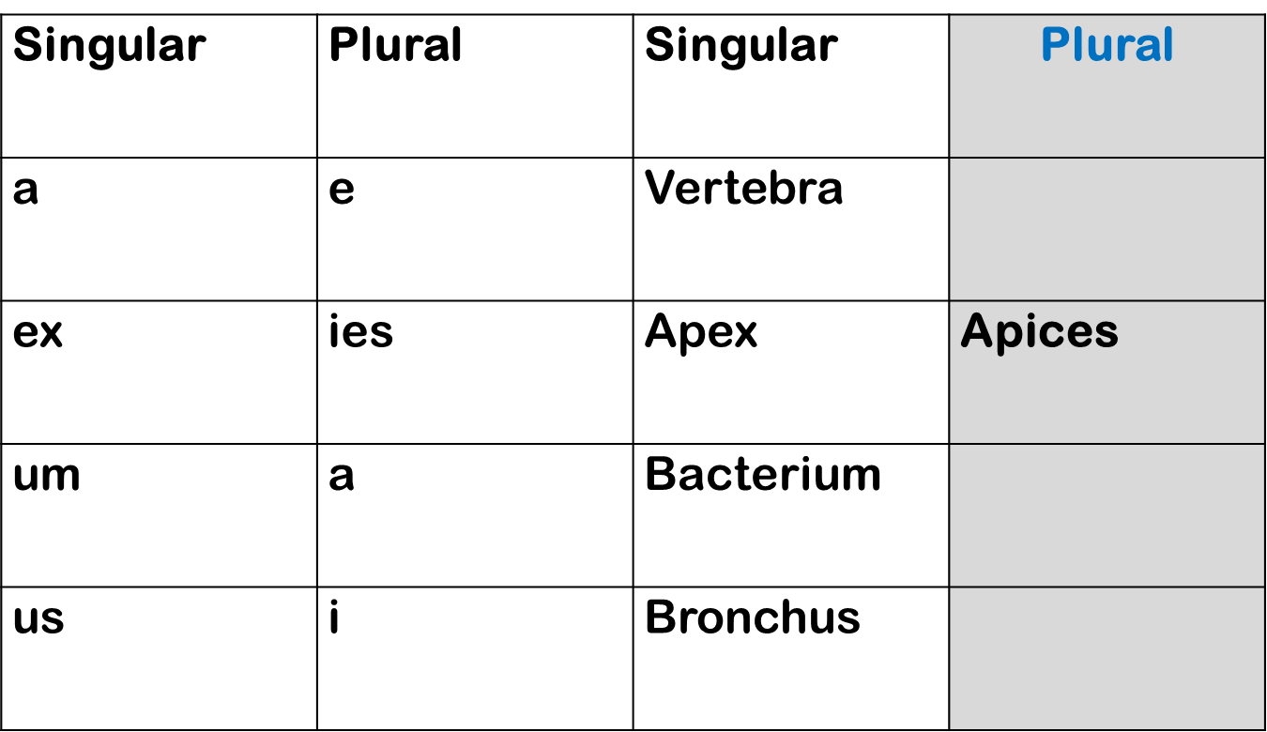
Activity – 10 Complete the following PLURAL FORMS

