Slide 2

What is StudentWeb?
In StudentWeb you can access:
unit plan or course guide explaining all about the subject you are studying
learning materials and activities
assessment requirements, including:
  Online quizzes
  Assignment uploads
Information like your timetable, calendar, results, email, and manage your personal ePortfolio
And you can communicate with your teacher, and other students

Slide 3
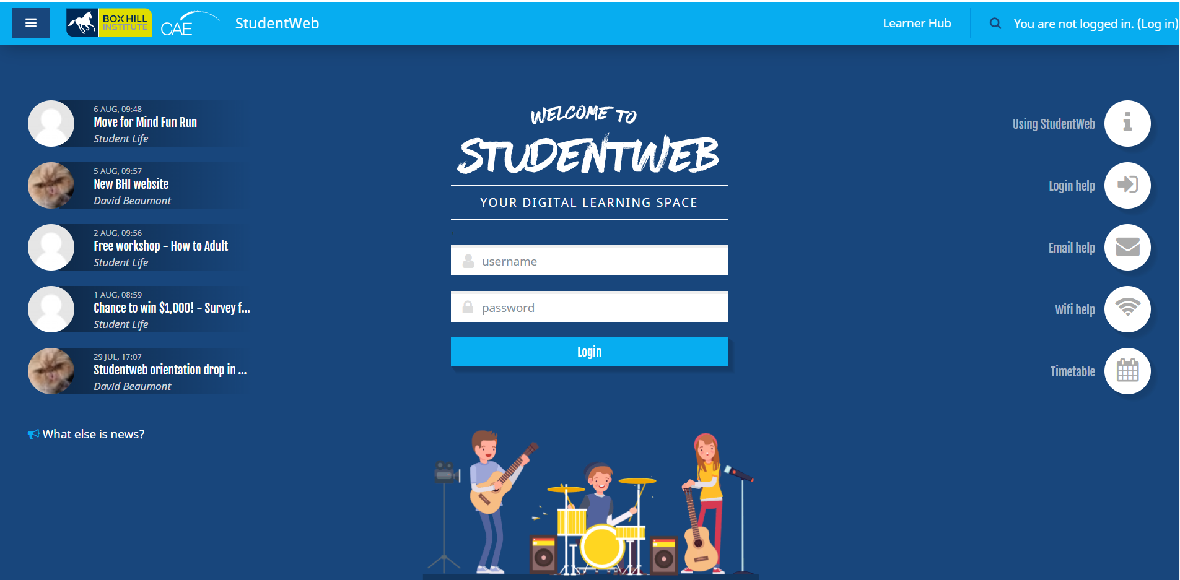
How to access StudentWeb
At the Institute - Open Chrome and you will automatically have instant access to StudentWeb as this is the Home page by default
At home - Connect to the internet and
  search the word StudentWeb
  or use the following link: http://studentweb.bhtafe.edu.au/

Slide 4
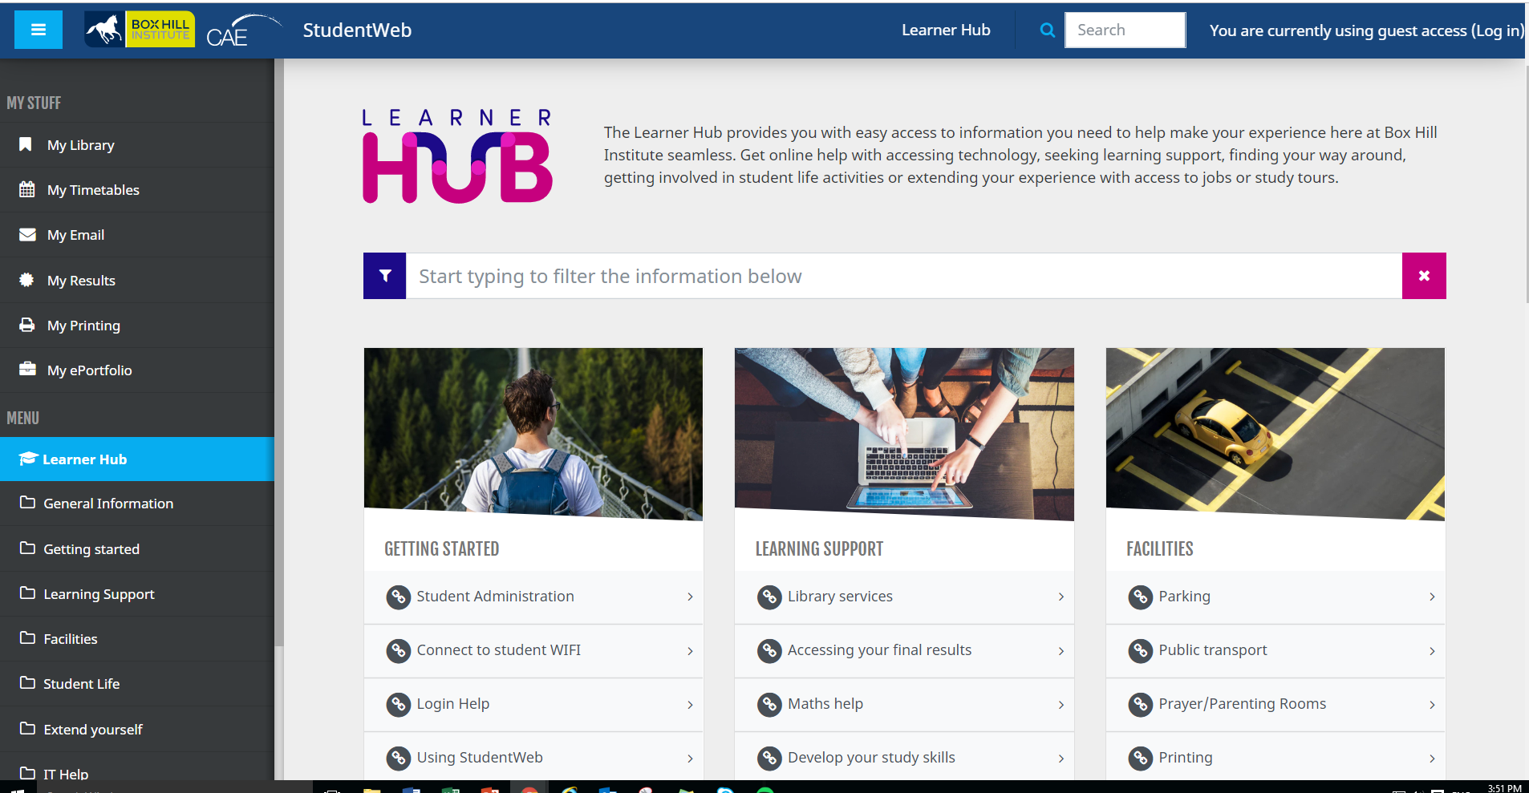
Services
Access information on the Learner Hub. The hub is available on the HOME screen without logging into StudentWeb
Get online help with:
accessing technology,
seeking learning support
finding your way around
getting involved in student life activities
extending your experience with access to jobs or study tours.

Slide 5
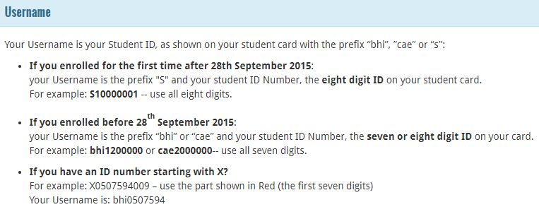
How to login to StudentWeb
Password
Once you enrol you will receive a temporary password by email to your personal email address. You can use this password on the log in page and StudentWeb will prompt you to create a secure password.

Slide 6
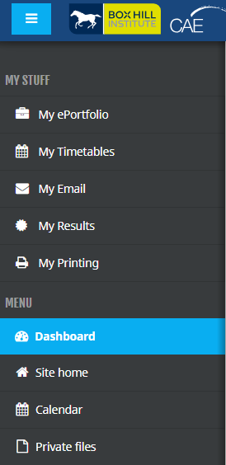
My Stuff Block
My ePortfolio | Access to Mahara ePortfolio which includes a weblog, resume builder and social networking system for connecting students and creating an online community.
My Timetable | Access to your personal timetable and group timetable. This will provide you with full details of all your classes including room number, time and duration of class and your teachers name.
My Email | Box Hill Institute Group use Microsoft Office 365 to host student email addresses. All official email from StudentWeb will go to this email account. You need to set up the account before the address will accept any mail.
My Results | This will provide you with a link to the Student Management System where you final results are located for each unit/subject.
My Printing | This allows you to manage printing using the printers in the Library. You can also recharge your account online using a credit card.

Slide 7
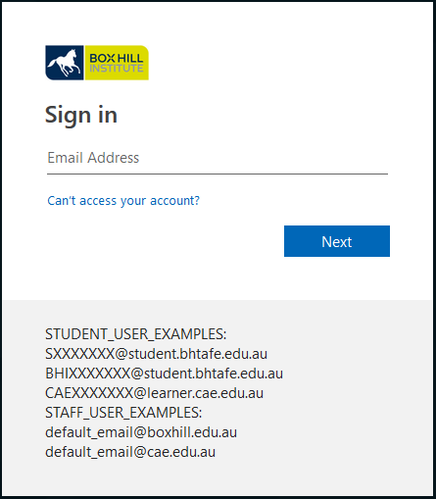
How to set up your email account
Your email must be activated before use, or before redirecting to your personal email.
Log into StudentWeb, and from My stuff, select My email.

Slide 8

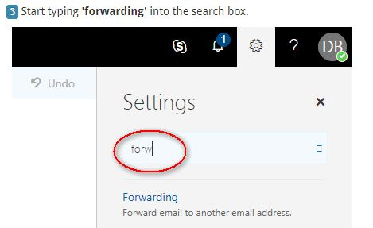
Redirecting your student email to another email account

Slide 9
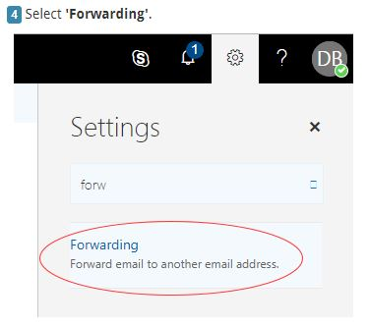
Redirecting your student email to another email account

Slide 10
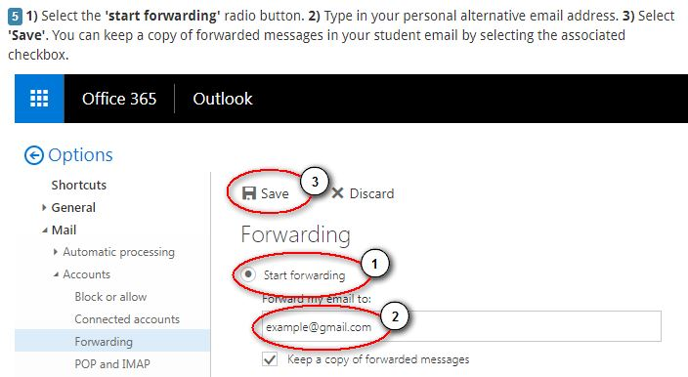
Redirecting your student email to another email account

Slide 11
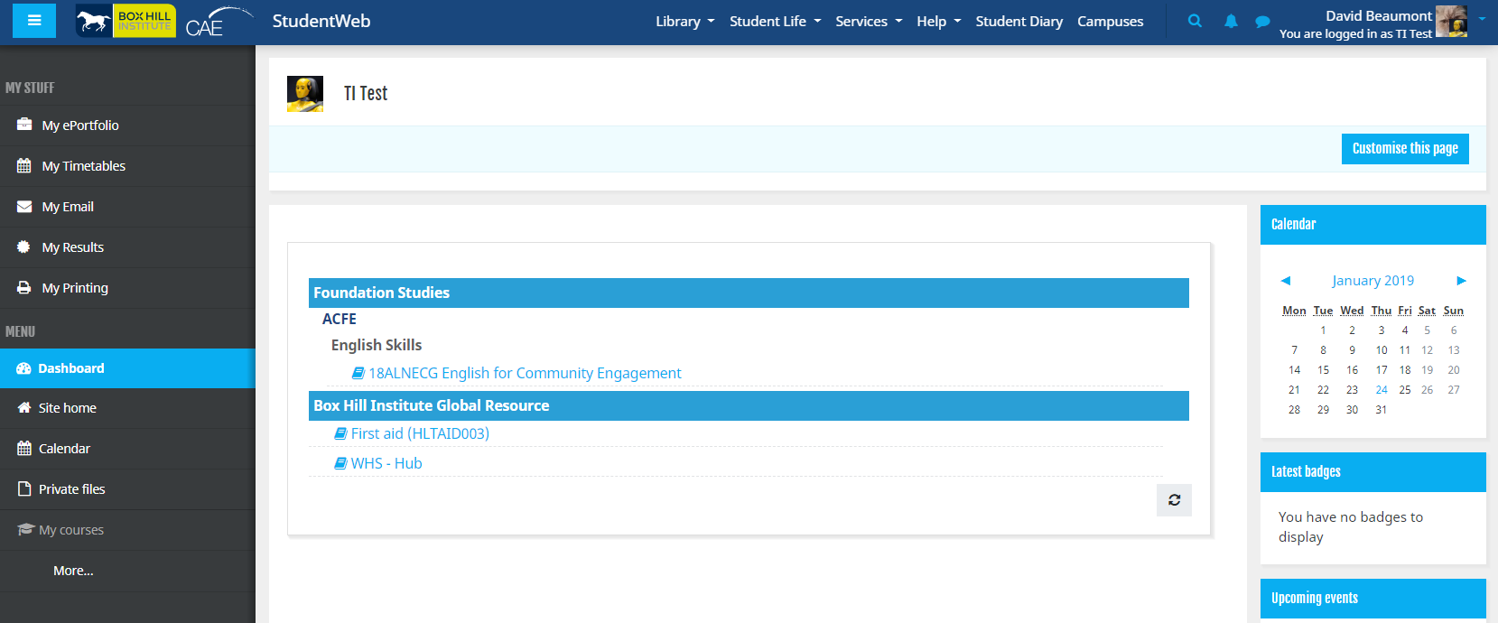
Access to your online units/subjects
Once logged in - you will see your online units in the centre of the screen. This screen is called Dashboard. If you cannot see the units/subjects you have enrolled in, speak to your teacher.

Slide 12
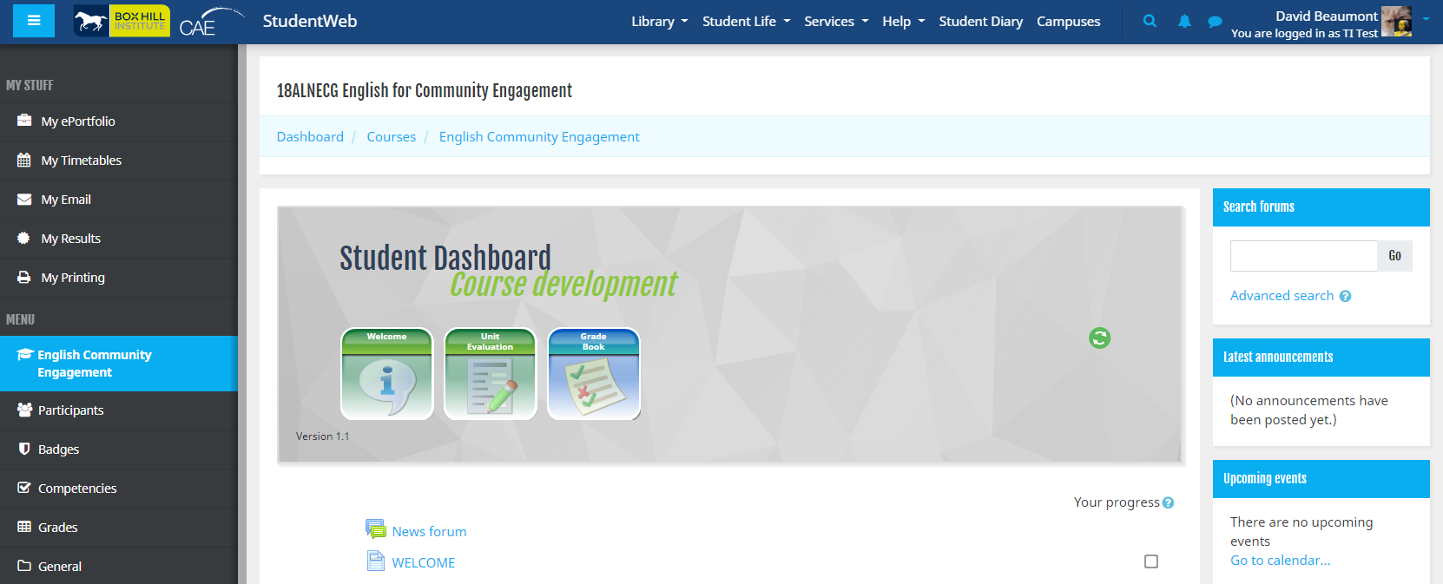
Example of online unit
Blocks

Slide 13

Online unit
Access to blocks and activities like:
  Forums
  Activities
  Latest announcements
  Upcoming events
  Recent activity
  My stuff
  Administration (Grades for unit)
  Navigation

Slide 14
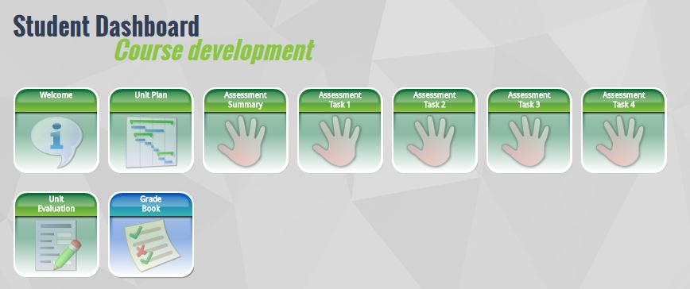
Student Dashboard
The Student Dashboard will give you quick access to the unit plan, learning outcomes, assessment tasks and gradebook. A tick will appear if you have viewed or submitted the required work.

Slide 15
Navigation bar
The navigation bar is located in the top of the unit, it is similar to a file path structure. You can access previous links in StudentWeb.

Slide 16
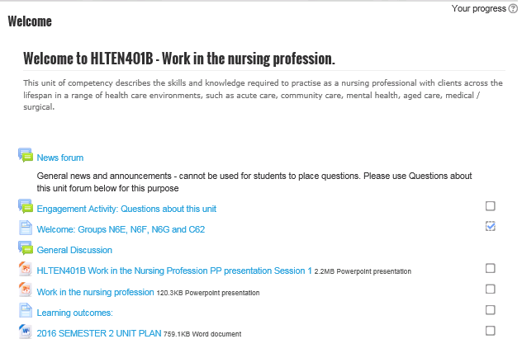
Access to resources and activities

Slide 17
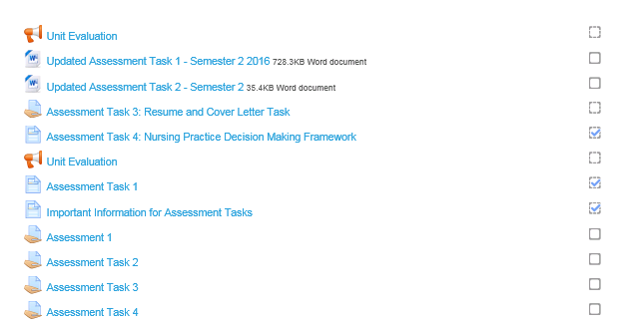
Assessment Tasks
To submit your assessment select the Assessment Task

Slide 18
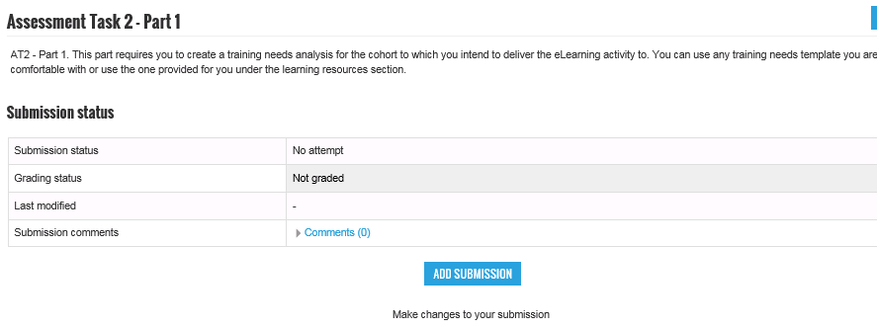
Submitting an assessment online
Open the assessment task.
Read the instructions.
Select Add submission you are ready to submit your assessment.

Slide 19
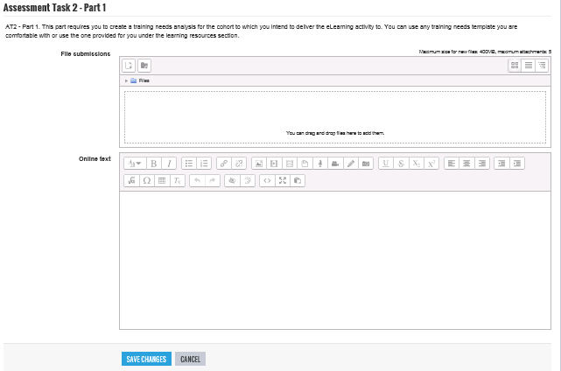
Submitting an assessment online
Drag and drop file here
Save changes
Make sure your file is saved on your PC or USB to access.
Drag and drop your file into the file submission area or browse for you file.
If required there may be an area to submit online text.
Select Save Changes

Slide 20
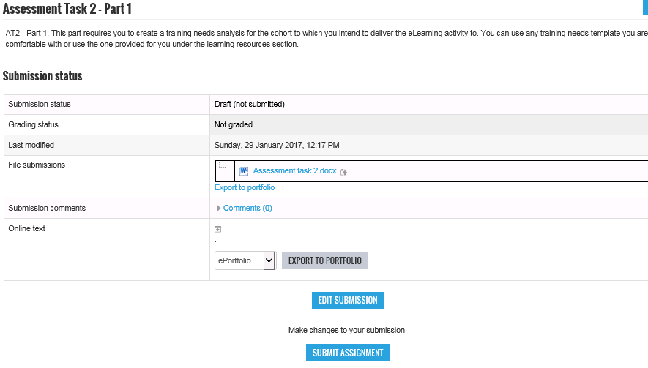
Edit or Submit Assignment
Submitted file
Edit submission (if required)
Submit assignment here

Slide 21
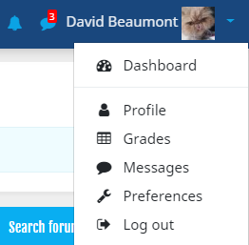
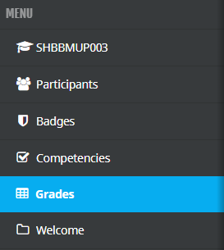
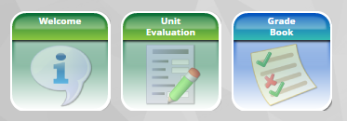
Grades
To access your grades for all your units select the drop down on the top right.
To access single or cluster unit Grades select Grades in the left menu or select the icon in the Student Dashboard

Slide 22
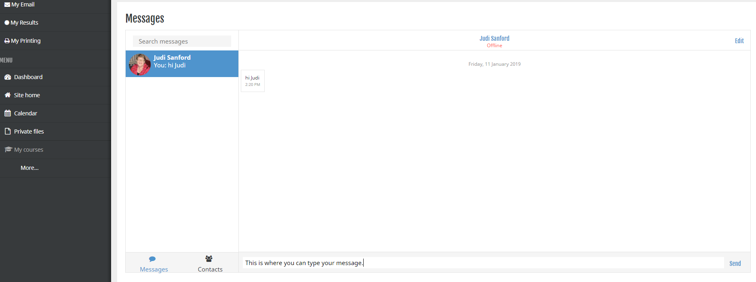

Messaging
Select this icon in the top right corner
Select new Messages or an existing contact
You can search for your teacher or peer
Select the persons name you want to message
Type your message and select Send Message

Slide 23
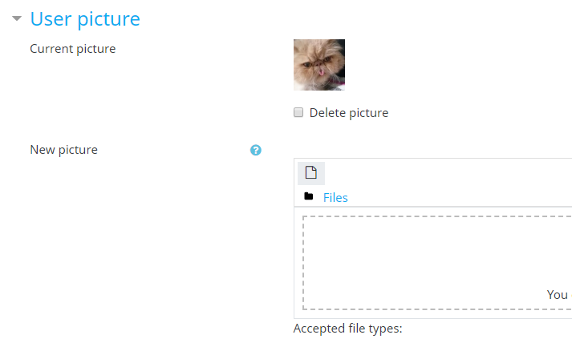
Adding your photo to your StudentWeb profile
You will need a photo in either .JPG or .PNG format, ideally square or nearly square. It will be cut to make it square, and resized to 100x100 pixels.
In the right-hand column, select the dropdown.
Select Profile
In the middle of the page in User details select Edit profile.
Scroll down to ‘User picture’
  You can either:
  a. Drag your image file into the big white box, or
  b. Click Add, then Upload a file, then Choose file.
  Then you’ll have to browse, find your photo, and Open, and Upload this file,
Now scroll down to the bottom of the page
Select Update profile.
And you’re done!

Slide 24
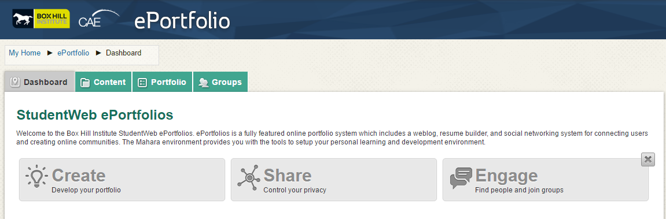
My ePortfolio
My ePortfolio lets you build an online collection of experiences, achievements and evidence of learning. You can store documents, videos, and photos, create blogs, build a résumé, track your goals, collaborate in groups, and present selected items to teachers, employers and friends. When you finish your course you can continue to use your ePortfolio by taking a copy with you.
Using My ePortfolio
To access your ePortfolio, click on the My ePortfolio link in the My Stuff section of StudentWeb.
The two main tabs that you will use in your ePortfolio include:
    The Profile tab – update your personal information, add a photo, and build an online resume.
    The My Portfolio tab – create views (i.e. web pages) to share items from your ePortfolio, upload files including images and documents, create a blog, and export your ePortfolio.

Slide 25


Need more help?
You can get StudentWeb support from:
Staff at any campus library
Support hub at all campuses or by calling 9286 9465

