Slide 1
The welfare, behaviour, and exercising dogs Cluster
ACMGEN303 - Assess the welfare status of an animal
ACMBEH301 - Identify behaviours and interact safely with animals
ACMGEN308 - Walk and exercise dogs
Session #4
All referencing for copyright purposes is located within the Notes section of this resource.
This resources covers the following performance criteria:
ACMGEN303: 1.1
ACMBEH301: None
ACMGEN308: None

Slide 2
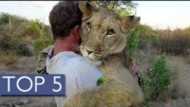
Unlikely animal friendships
https://youtu.be/rl_RzCdwOts

Slide 3
Human-animal bond
We know dogs have been an integral part of the lives of humans for a very long time
The human-animal bond is described as a mutually beneficial relationship between people and animals that is essential to the health and well-being of both

Slide 4
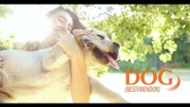
Human-animal bond
https://youtu.be/wXwt62moB7w

Slide 5

Human-animal bond
https://youtu.be/K8ZmbR5Lw7k

Slide 6
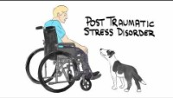
Human-animal bond
https://youtu.be/2qSSHdaoylM

Slide 7
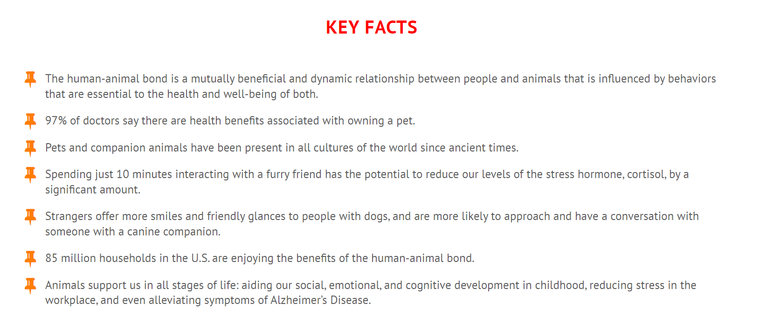
Human-animal bond

Slide 8
Anthropomorphism
The use of human characteristics to describe or explain nonhuman animals.
Hotly debated
Let’s watch: https://youtu.be/kwlluAXRzpQ

Slide 9

Anthropomorphism

Slide 10
Current thoughts:
The important fact is that we know that the assortment of emotions available to the dog will not exceed that which is available to a human who is two to two-and-a-half years old.
This means that a dog will have all of the basic emotions: joy, fear, anger, disgust, and, yes, love, but the dog does not experience the more complex emotions like guilt, pride, and shame.
Many would argue that they have seen evidence indicating their dog is capable of experiencing guilt.
The usual situation recounted is one in which you’ve come home and your dog starts slinking around showing discomfort, and you then find that he has left a smelly brown deposit on your kitchen floor. It is natural to conclude that the dog was acting in a way that shows that he is feeling guilty about his transgression.
Despite appearances, this is not guilt, but simply a display of the more basic emotion of fear. Your dog has learned that when you appear and his droppings are visible on the floor, bad things happen to him. What you see is his fear of punishment; he will never feel guilt because he is not capable of experiencing it.

Slide 11
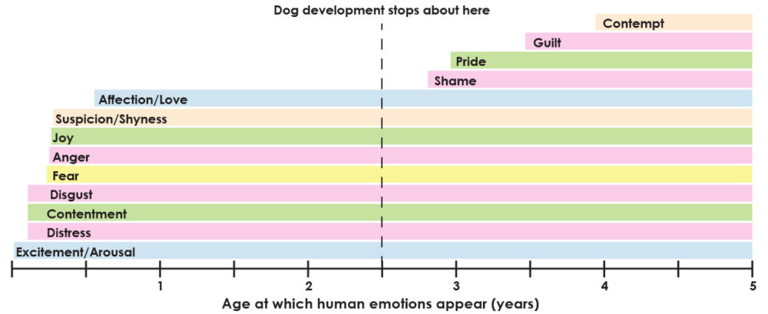

Slide 12
How might this impact teaching a dog to walk calmly on a lead?
Without the ability to feel guilt/shame, is negative punishment worthwhile?
We don’t teach training in this cluster, but it is certainly an interesting topic.

Slide 13
Sentience
The ability to feel, perceive or experience subjectively
Dogs are not only capable of feeling pain and distress, but also of having positive experiences such as comfort, pleasure or interest that are appropriate to the particular species, environment and circumstances
Dogs seek positive experiences and avoid negative ones

Slide 14
Sentience
Occurs regardless of a dog’s intelligence
suffering and pleasure are defined as the ability to feel, and not by the ability to think
Recognition of animal sentience in law may go above simply protecting animals from pain or suffering, as the definition of sentience includes both positive and negative states, thus promoting positive welfare, not simply protecting against poor welfare.
This is why it is so exciting that our new legislation is being named things like “Animal Welfare Act” rather than “Prevention of Cruelty to Animals Act” – one is positive, the other is the bare minimum.

Slide 15
Animal what? These definitions are important:
Animal care:
The treatment that an animal receives
Animal husbandry:
The day to day raising, upkeep, and care of animals
Animal welfare:
The physical and psychological, social and environmental well-being of animals
Animal ethics:
The philosophical study of why animals matter morally, and how we should treat and care for animals.

Slide 16
Animal Welfare
Sentience is the reason that animal welfare matters
Read page 8-12/14 of Readhttps://wsava.org/wp-content/uploads/2019/12/WSAVA-Animal-Welfare-Guidelines-2018.pdf
What is good animal welfare? – RSPCA Knowledgebase
Read page 12-13 of 24 https://agriculture.vic.gov.au/__data/assets/pdf_file/0003/562386/Animal-Welfare-Action-Plan-Dec-2017.pdf

Slide 17
Animal Welfare in Australia
Read:https://www.agriculture.gov.au/agriculture-land/animal/welfare/aaws
How does Australia pull up? Australia | World Animal Protection

Slide 18
Animal Welfare and ethical Issues in Australia and the animal care industry

Slide 19

Society’s attitude
More dog owners in Australia than ever before
  COVID increased this significantly
But COVID brought its own animal welfare issues
  Carpark dog sales increased as unable to go to people’s homes
  Increase in $ of dogs, not necessarily of good quality/with vaccines/microchips/health checks
More concerned with animal welfare than before
  Increase in public request for stronger animal cruelty laws
  Tenancy laws changed to reflect pet ownership as an expectation

Slide 20
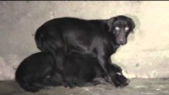
Oscars Law
https://youtu.be/InmKjGZGx98

Slide 21

Oscars Law
https://youtu.be/7kTLAxr1Yzk

Slide 22
Stakeholder positions
Animal Welfare issues – DAWE
Australia is increasingly uncomfortable with animal cruelty helped by Oscar’s Law lead to amendments to the puppy farm legislation
PETA’s Take
Animal Liberation’s Take
Companion Animals – Onewelfare (sydney.edu.au)

Slide 23

Amendments to the puppy farm legislation
https://youtu.be/OxwMOgCVS_g

Slide 24
Greyhounds
What are the animal welfare issues with greyhound racing? – RSPCA Knowledgebase
Must stay on lead when re-homed
Previous laws meant must be muzzled when off the home property but public outcry has since reversed this
  Breed-specific laws and pedjudice penalizes the individual dog

Slide 25
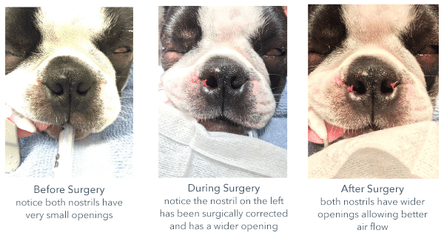
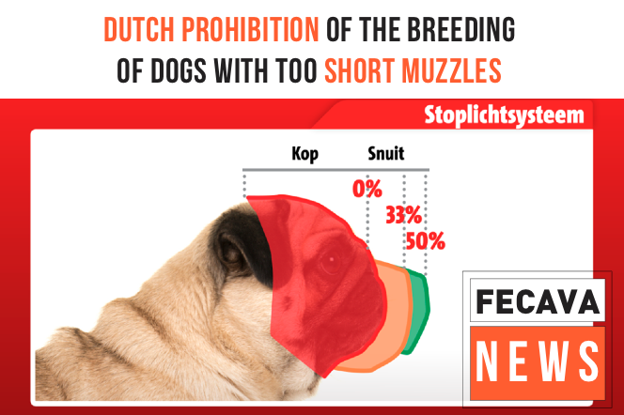
Brachycephalic dogs
Love is Blind campaign
Welfare implications from breeding, owning, exercising
  https://www.dailymail.co.uk/news/article-10475455/Call-BAN-French-Bulldogs-Pugs-Australia.html

