Slide 1
The welfare, behaviour, and exercising dogs Cluster
ACMGEN303 - Assess the welfare status of an animal
ACMBEH301 - Identify behaviours and interact safely with animals
ACMGEN308 - Walk and exercise dogs
Session #5
All referencing for copyright purposes is located within the Notes section of this resource.
This resources covers the following performance criteria:
ACMGEN303: 1.2, 2.1, 2.2, 2.4, 3.1, 3.2, 3.4, 4.1, 4.2
ACMBEH301: None
ACMGEN308: None

Slide 2
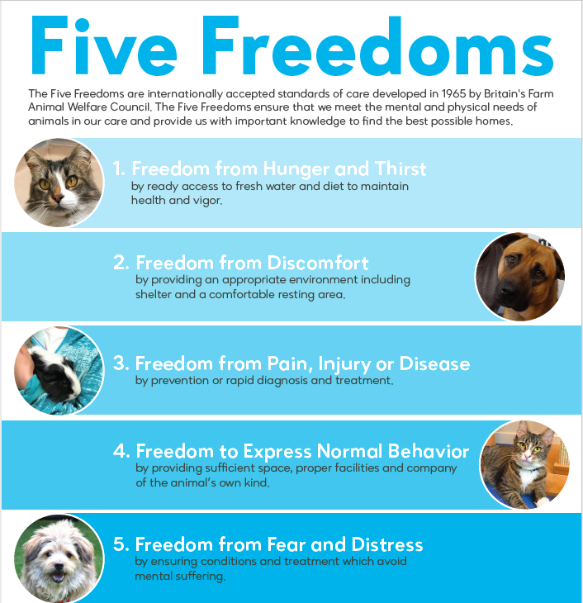

Slide 3
If you had the five freedoms:
Would you be content?
Would it be a “good” life?
Would you be mentally healthy?

Slide 4
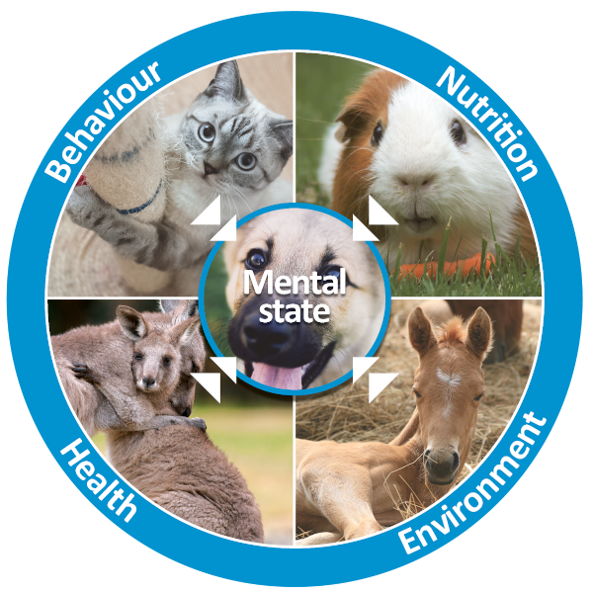
The Five Domains
Five Domains – Onewelfare (sydney.edu.au)

Slide 5
How do they differ?
Read: What are the Five Domains and how do they differ from the Five Freedoms? – RSPCA Knowledgebase
Freedoms | Domains
From hunger and thirst | Nutrition
From discomfort | Environment
From pain, injury, and disease | Health
To express normal behaviour | Behaviour
From fear and distress | Mental State

Slide 6
The Five Domains Model
The Model emphasises that what matters to animals in welfare terms is their subjective experiences, i.e., their affects. It also recognises that particular physiological mechanisms and specific affects interact dynamically.
When the conditions in Domains 1 to 4 give rise to negative affects, they tend to be welfare compromising; when they give rise to positive affects, they tend to be welfare enhancing.
Thus, the Model provides a coherent and informative basis for evaluating the welfare significance of different conditions.

Slide 7
Animal Welfare Assessment Framework
Animal Welfare Assessment Framework - Science & Research - Topics - Campaigns & Topics - FOUR PAWS Australia (four-paws.org.au)

Slide 8
Let’s look at:
The 2020 Five Domains Model for Animal Welfare Assessment and Monitoring
Link - https://www.ncbi.nlm.nih.gov/pmc/articles/PMC7602120/

Slide 9

Sector-specific strategies to improve welfare
Disease prevention/vet treatment

Slide 10
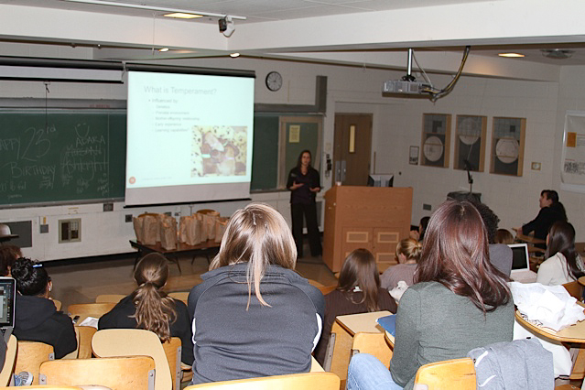
Sector-specific strategies to improve welfare
Knowledgeable and skilled care/staff/management
Backed by the COP

Slide 11
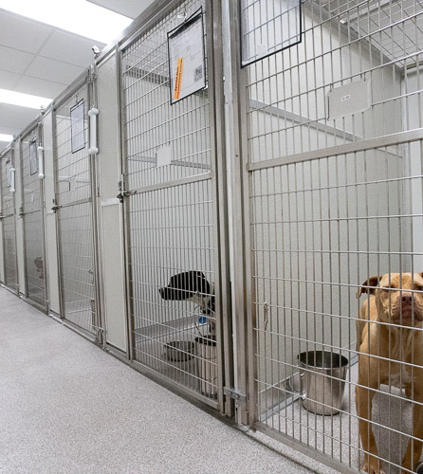
Sector-specific strategies to improve welfare
Environmental factors

Slide 12
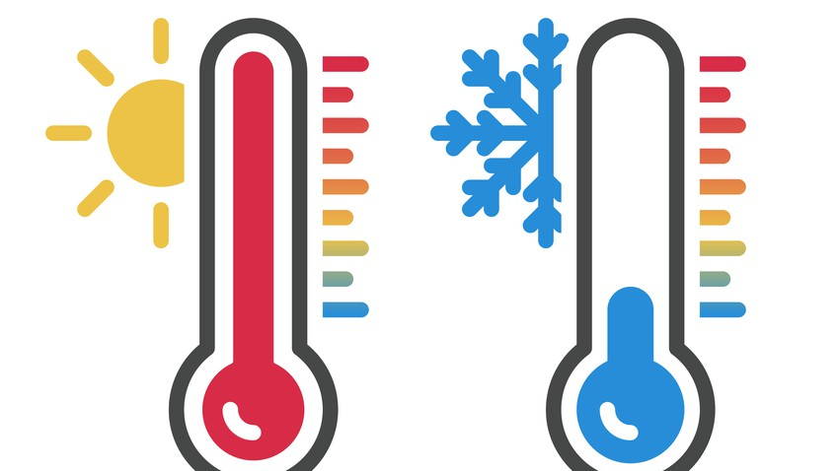
Environmental factors
Temperature
Must be maintained at species optimum
If too high?
If too low?

Slide 13

Environmental factors
Sunlight
Vitamin D = good
Too much of a good thing is not necessarily good
Sunburn
Fluctuations to temperatures in enclosures if exposed to direct sunlight

Slide 14
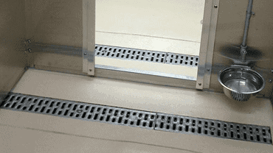
Environmental factors
Moisture
If too high?
  Mould
  Fungal infections
If too low?
  Respiratory issues
  Irritation of mucous membranes
  Dry skin

Slide 15
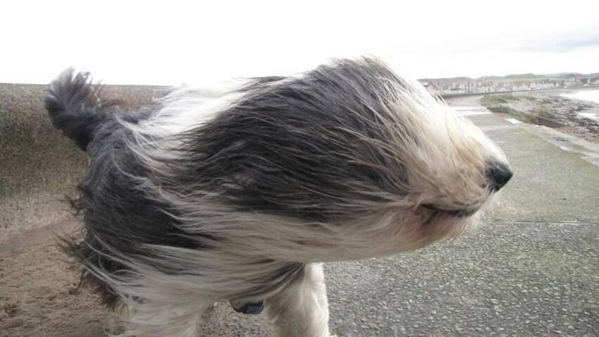
Environmental factors
Wind
Stress
Self-injury
Deteriorated health status

Slide 16
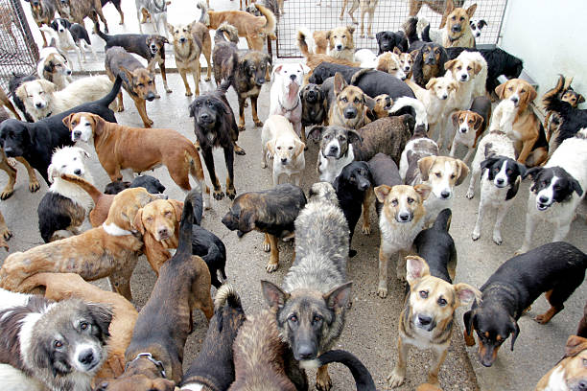
Environmental factors
# of other dogs housed in area
Noise +++ = stress
Disease transmission opportunity is higher

Slide 17
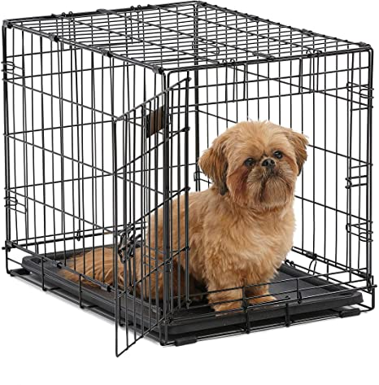
Environmental factors
Enclosure size
Correct measurements allow for animal to express normal behaviour for species/breed
Individual – some dogs may prefer smaller enclosure when first admitted/surrendered so as to not feel overwhelmed

Slide 18

Sector-specific strategies to improve welfare
Species/breed/individual-appropriate physical environment
Species traits
Breed traits
Individual traits

Slide 19
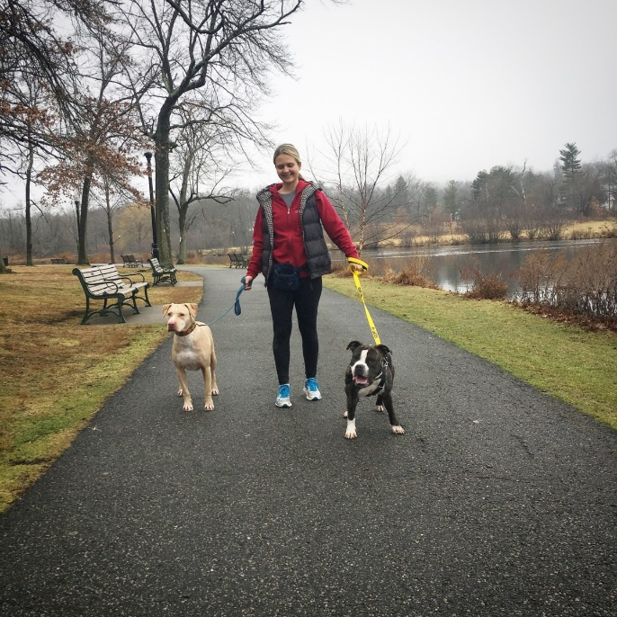
Sector-specific strategies to improve welfare
Species appropriate social opportunities
Must keep business policies in mind
What can we do if we think an animal’s welfare might improve exercising with another dog instead?
  Supervisor

Slide 20
Sector-specific strategies to improve welfare
Species/breed-specific behaviours and environmental choices
Indoor/outdoor kennels
Enrichment items
Cuddles
Play
Grooming
Knowledge of breeds/types/groups/history

Slide 21
Sector-specific strategies to improve welfare
Humane interactions and handling
Coming up shortly! ☺

Slide 22
Animal welfare assessments
Cover:
Nutrition
Social and physical environment
Health
Behaviour
Emotional State
If euthanasia is appropriate

Slide 23
Lets:
Look at an animal welfare assessment tool – AT2
And lets look at the Welfare Assessment Protocol for Shelter Dogs as a tool to help us see what we would fill in the tool
Link - ProtocolloShelterQuality_EN_2016-DEF.pdf (izs.it)

Slide 24
Let’s look at animal welfare in action
RSPCA Puppy Farm Rescue – YouTube
Watch to 2.36: Use The 2020 Five Domains Model for Animal Welfare Assessment and Monitoring
https://studentweb.bhtafe.edu.au/pluginfile.php/2523150/mod_resource/content/0/2020%20Five%20Domains%20Model%20adapted%20by%20Horses%20and%20People%20%281%29.pdf
to decide what is at risk
Watch the remainder of the video for a happy ending ☺

Slide 25
Let’s look at animal welfare in action
Kelly's story – YouTube
Watch to 1.30: Use The 2020 Five Domains Model for Animal Welfare Assessment and Monitoring to decide what is at risk, and what Kelly needs to have her domains filled.
Watch the remainder of the video for a happy ending ☺

