Slide 1
The welfare, behaviour, and exercising dogs Cluster
ACMGEN303 - Assess the welfare status of an animal
ACMBEH301 - Identify behaviours and interact safely with animals
ACMGEN308 - Walk and exercise dogs
Session #8
All referencing for copyright purposes is located within the Notes section of this resource.
This resources covers the following performance criteria:
ACMGEN303: None
ACMBEH301: 2.2, 2.3
ACMGEN308: None

Slide 2
How did your assigned homework go?
Did you watch: Speaking Dog! Canine Communication #1 of 3

Slide 3
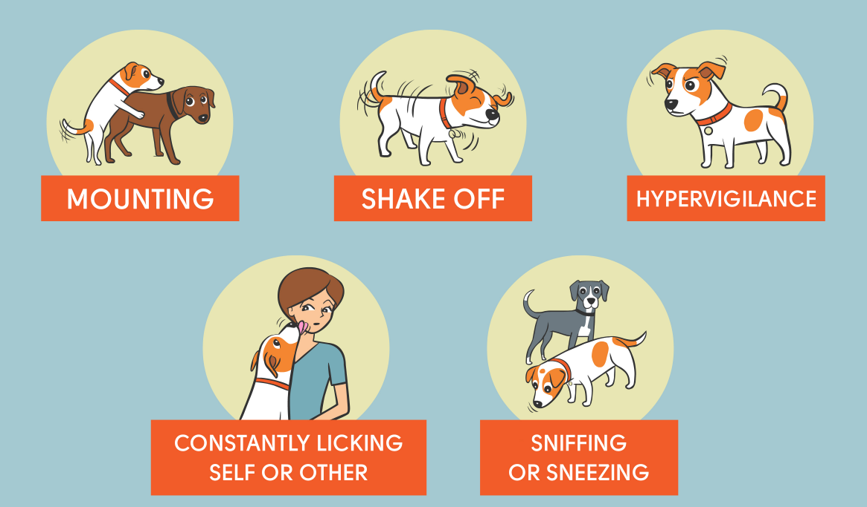
Early stress signals:
Which have we discussed already?

Slide 4
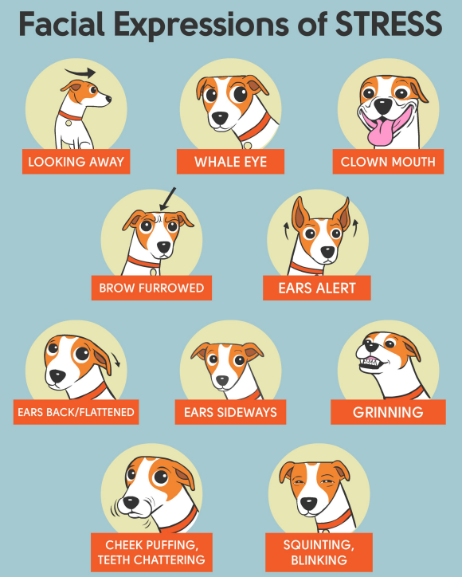

Slide 5
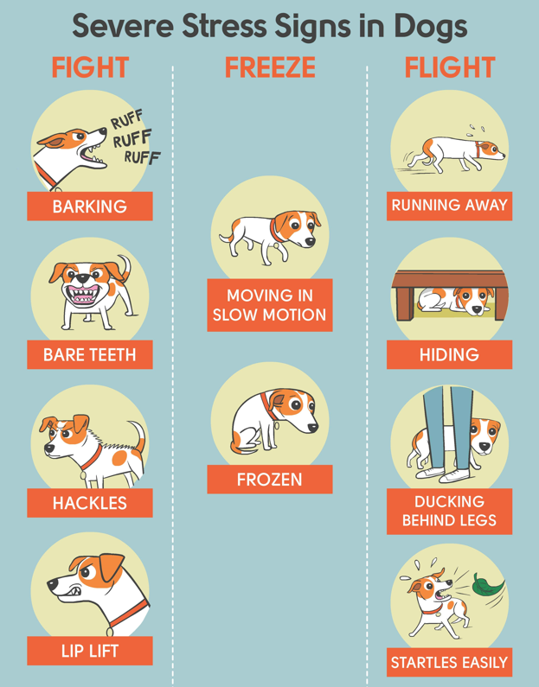

Slide 6
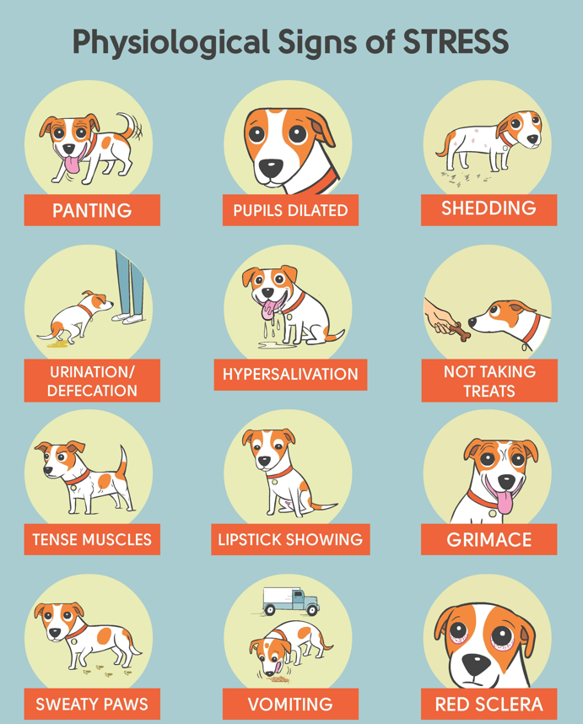

Slide 7
Pick the body language being shown by each dog and decide which picture of each is the most relaxed

Slide 8
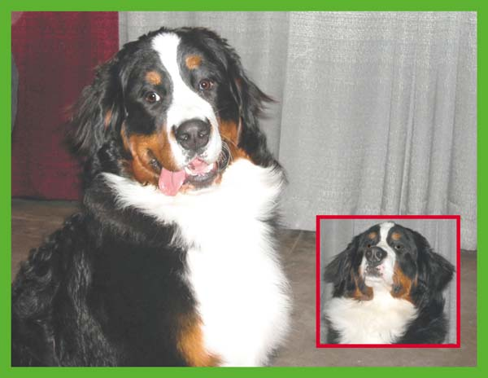

Slide 9


Slide 10
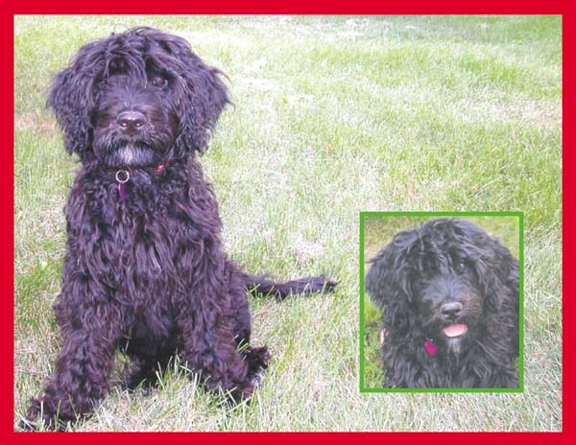

Slide 12
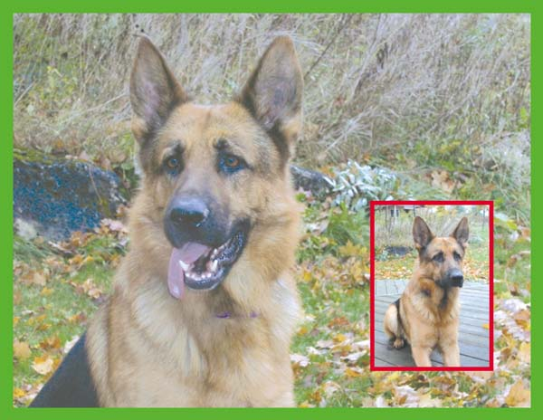

Slide 14
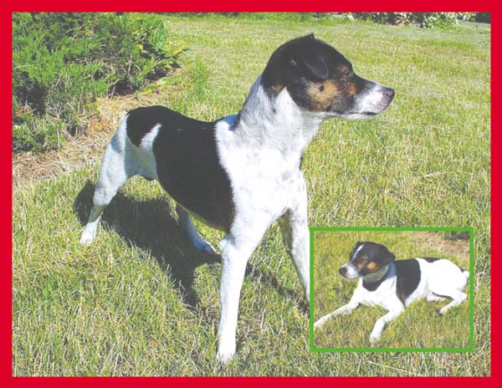

Slide 16
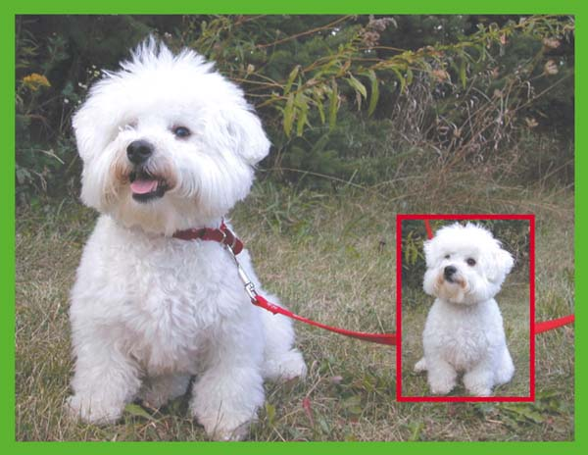

Slide 18
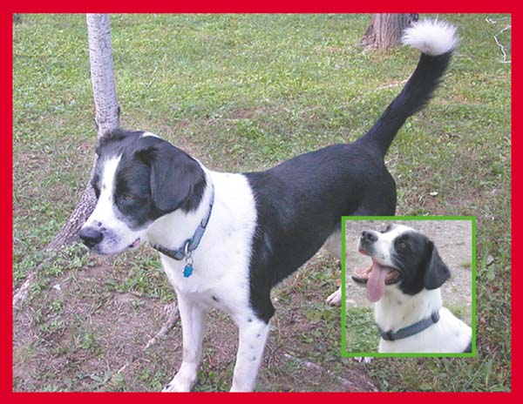

Slide 20
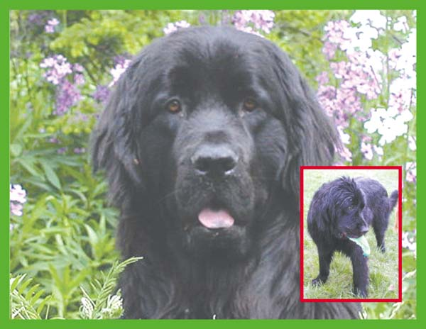

Slide 22
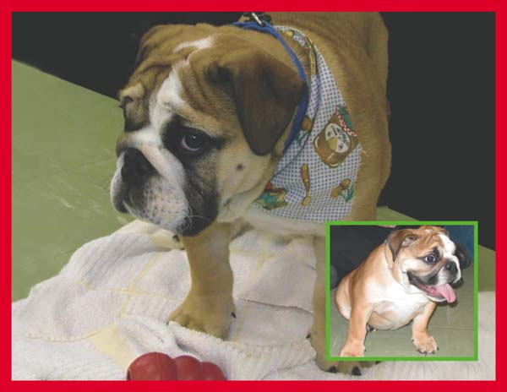

Slide 24
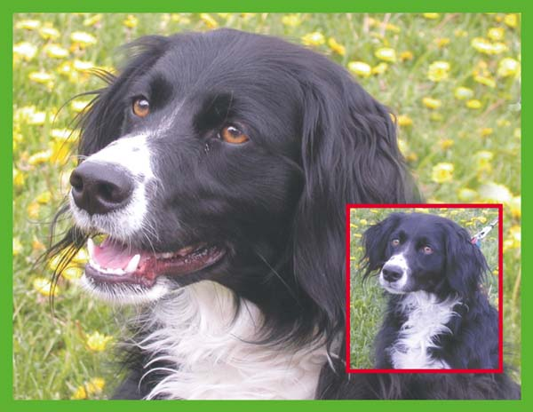

Slide 26
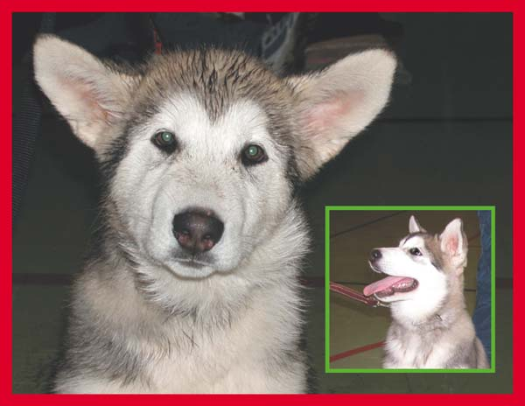

Slide 28
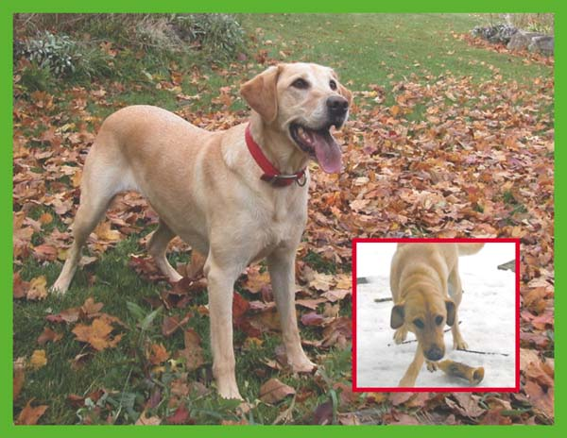

Slide 30

Fear, Anxiety and stress
(FAS Scoring)

Slide 31
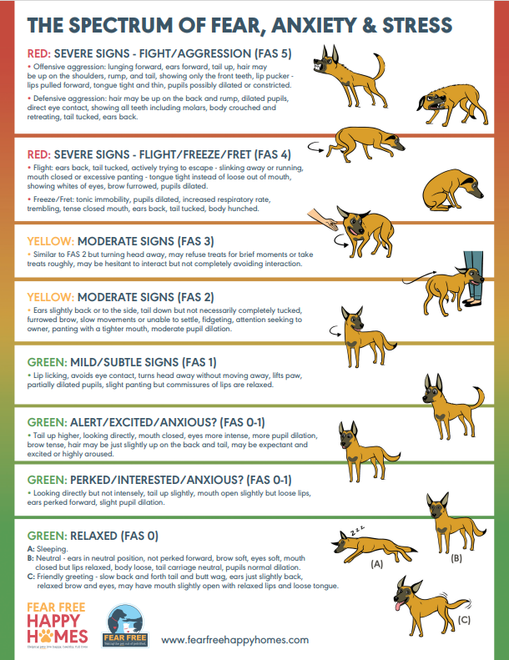
FAS Scoring
Traffic light system for emotional state/arousal level of the dog
  Green = positive/neutral, moving to yellow/red indicates negative state
Assess behaviour and body language and match to the score out of 5 + colour

Slide 32
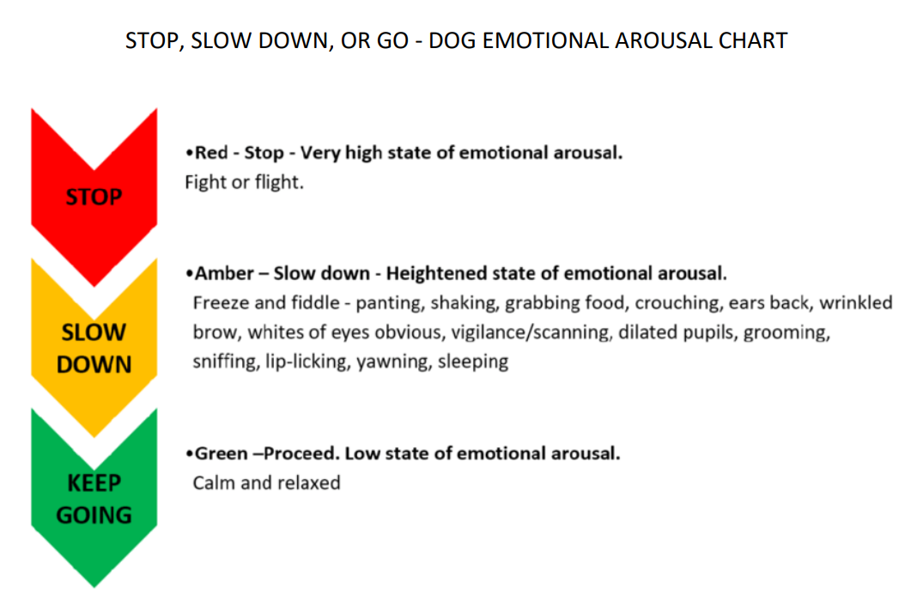

Slide 33
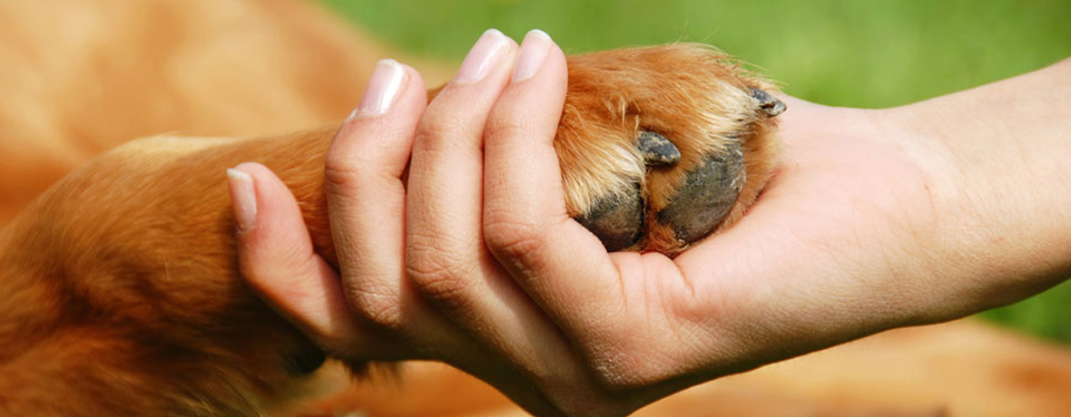
Carer-animal relationship involvement
Handling animals repetitively allows for a relationship to build where less stress may be experienced on the dog’s part (ie lower FAS ratings)
  But not always possible in animal care industry
    Shelter: hopefully dog is adopted quickly
    Kennel: long time between visits
    Vet hospital: hopeful return to good health and not seen for a year
Handling a dog repetitively also increases the chances you pick up on the smaller, less obvious signals earlier, again reducing the FAS rating as you will know when to withdraw from a scenario causing issues for the dog etc

Slide 34
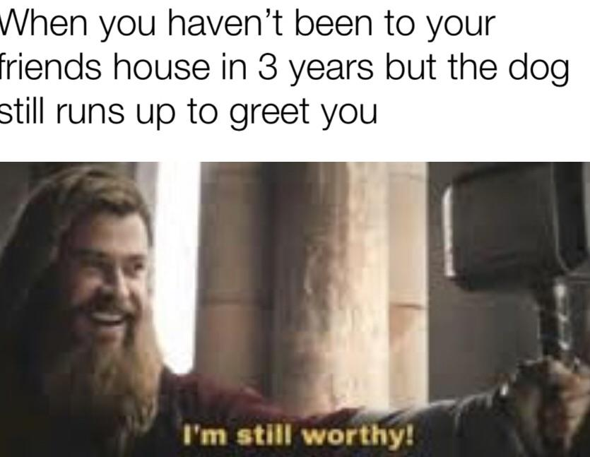

Slide 35
Call out when you see a new behaviour/body language:
Please note that in the following videos none of these approaches, training methods, or trainer behaviours are condoned by any means.
The purpose is to use footage showing behaviours of canines to support your learning of reading body language and signs

Slide 36
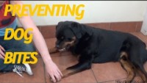
Call out when you see a new behaviour/body language:
Watch me (start at minute 8.15, play on mute)

Slide 37

Call out when you see a new behaviour/body language:
Watch me (start at start, play w sound)
  What behaviours did the trainer miss?

Slide 38
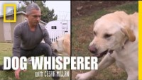
Call out when you see a new behaviour/body language:
Watch me (start at start, play with sound)

Slide 39
Activity
Online Activity: Dog body language recognition

Slide 40

Speaking Dog! Canine Communication #2 of 3
Watch the recording
Recognize what dogs are communicating
Identify how to respond properly to dogs based on their body language
How dogs learn about others using their sense of smell

Slide 41
Homework
Complete anything outstanding from today
Dog Park Activity Observation
Watch the recording for video #3/3
Online Activity: Dog body language recognition if not completed earlier

