Slide 1
The welfare, behaviour, and exercising dogs Cluster ACMGEN303 - Assess the welfare status of an animal ACMBEH301 - Identify behaviours and interact safely with animals ACMGEN308 - Walk and exercise dogs
Session #2
All referencing for copyright purposes is located within the Notes section of this resource.
This resources covers the following performance criteria:
ACMGEN303:
ACMBEH301: 1.1, 1.3, 1.4, 3.1, 4.3
ACMGEN308: 1.2, 2.7

Slide 2
Common activities in animal care sectors Group discussion
What tasks do animal attendants do?

Slide 3
Animal attendants are responsible for carrying out the following duties and must report to the operations manager on these duties:
daily feeding, watering and inspection of all animals
daily cleaning of animal housing areas, i.e. hose out, replace bedding, litter trays, feeding and watering utensils
administering medication and treatment as prescribed by veterinary practitioner
routine disinfection of animal housing areas and equipment
exercising of animals as required
provision of environmental enrichment for the animals

Slide 4
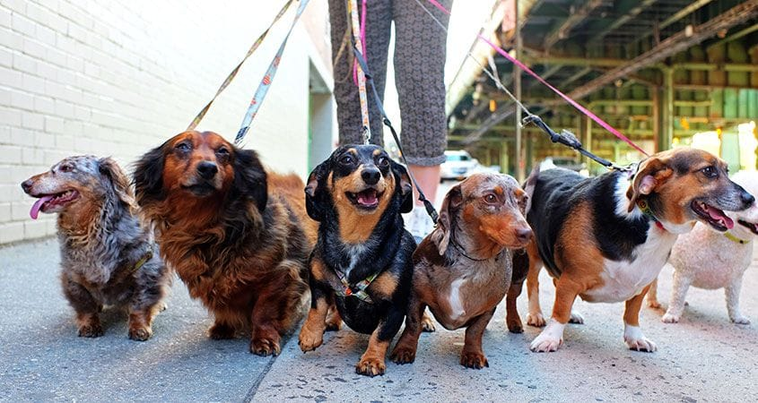
Our main one in this cluster is:

Slide 5
Hazards to human and animal’s when walking/exercising

Slide 6
Hazards to US (WHS)
What can you think of?

Slide 7
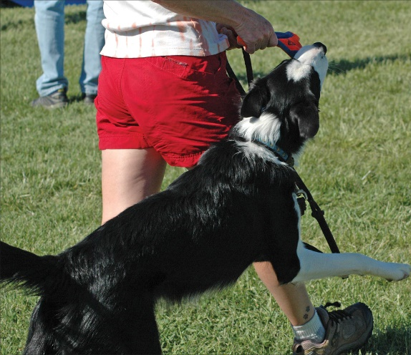
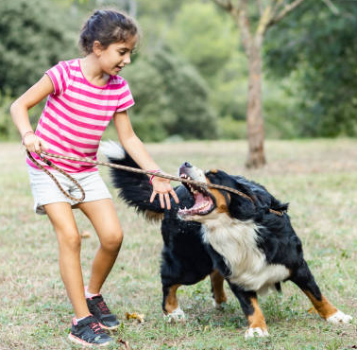
The animal
Risks
Control/reduction/minimisation measures
Bites (not necessarily aggression – could be arousal/accidental biting!)
Scratches
Transmission of zoonoses
Training
Observation of body language and behaviour to pre-empt issues
Hygiene measures
Observations of health prior to interaction

Slide 8
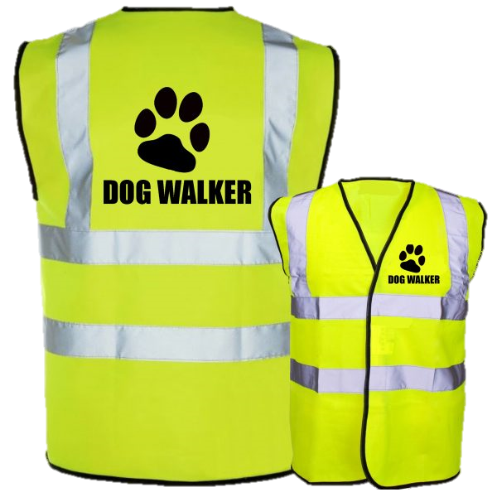
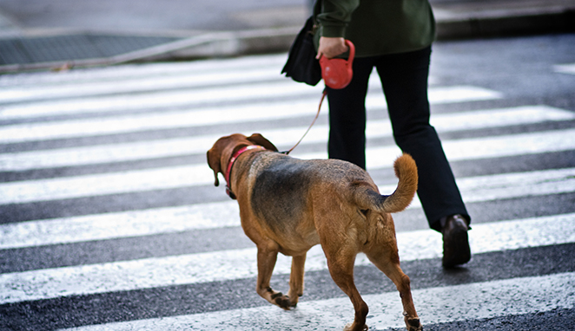
Cars/traffic
Risks
Control/reduction/minimisation measures
Getting run over/injured
Road safety
Wearing high vis external layer
Not walking a dusk/low light times if possible, choosing tracks with no/minimal road crossings

Slide 9
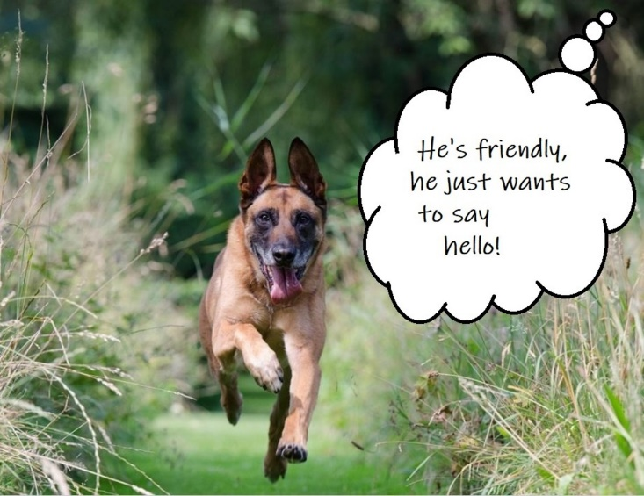
Other animals in area
Risks
Control/reduction/minimisation measures
Other dogs off leash, foxes, wildlife, snakes, spiders etc
Bites, scratches, injuries, envenomation
Not walking through long grass
Being observant of surroundings
Selecting walking tracks that best suit the dog you are walking (ie not through an off-leash dog park with a dog-aggressive dog) so that on top of the worry about the approaching dog, it is not worsened by a dog-fight you are in the middle of

Slide 10
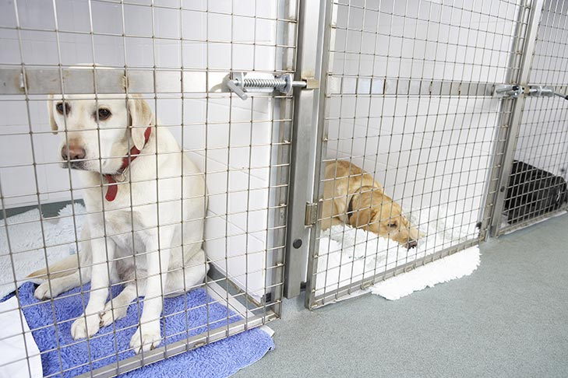
This begins well before the walk starts…
Are other dogs being taken out of the kennel at the same time?
Communicate verbally with other attendants in area to decide who will move out first

Slide 11
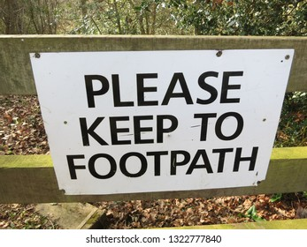
Terrain
Risks
Control/reduction/minimisation measures
Wet/slippery, long grass, grass seeds etc
Appropriate footwear
Stay on set paths

Slide 12
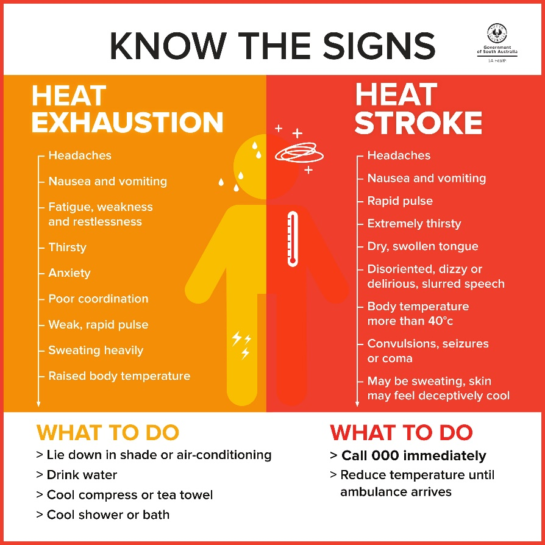
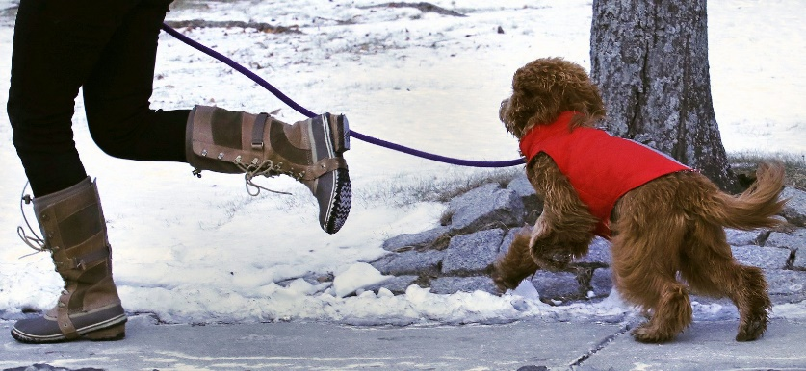
Environmental conditions
Risks
Control/reduction/minimisation measures
Wet, hot, cold, humid, stormy etc
Plan!
Check weather apps
Avoid walking on hot days/times
Appropriate clothing/PPE – rain jacket, jumper, gloves, hat, sunscreen, high vis vest

Slide 13
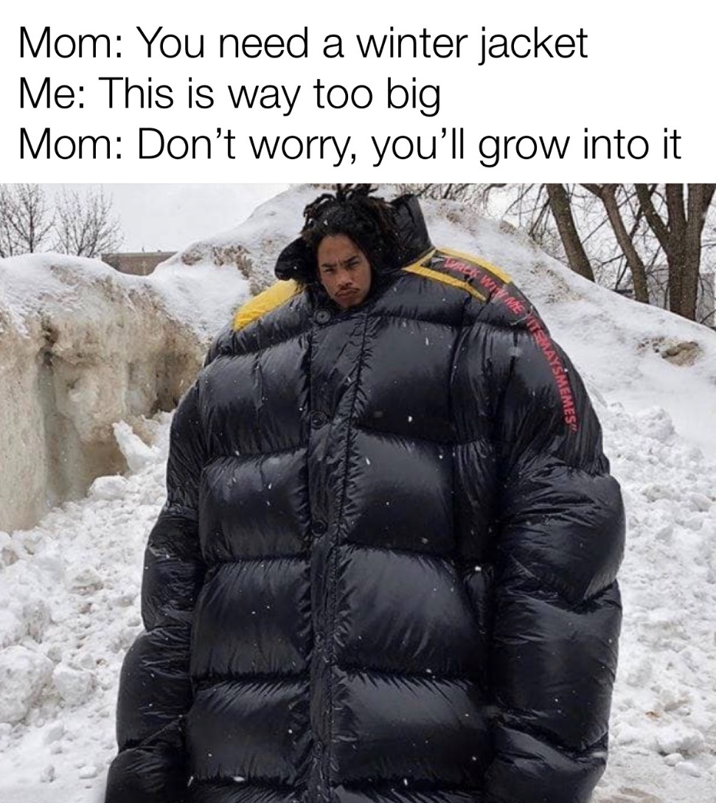
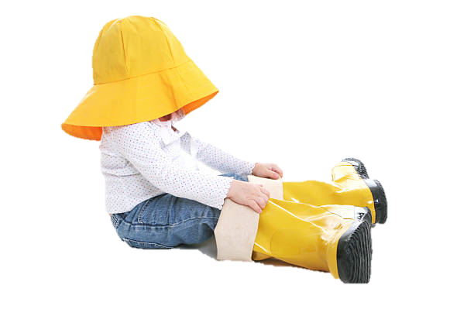
BUT! PPE MUST FIT CORRECTLY
Or it becomes a hazard itself…

Slide 14
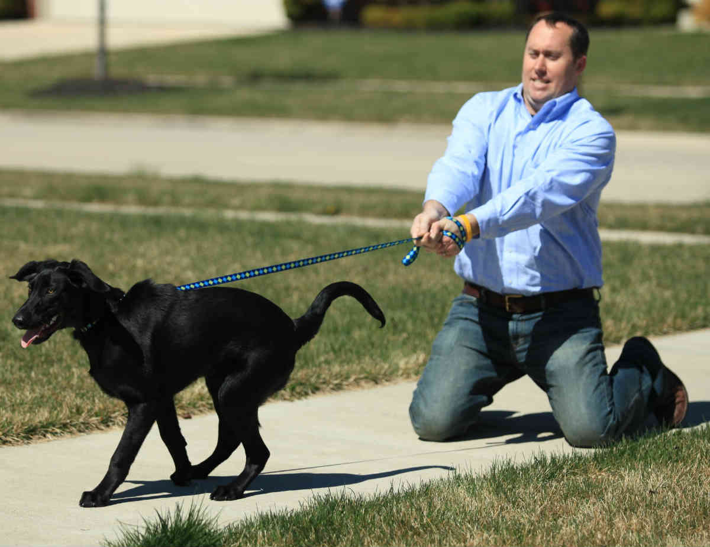
Manual handling
Risks
Control/reduction/minimisation measures
Getting dog on/off transport to walking track if required, dogs pulling on lead
Training (for YOU!)
Choosing correct walking equipment (appropriate lead/harness for dog in question, treats, toys etc)
Use of another person to life/manouvre etc

Slide 15
Hazards to our dogs (Animal Welfare)
What can you think of?

Slide 16
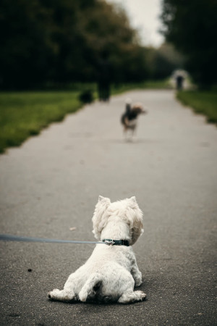
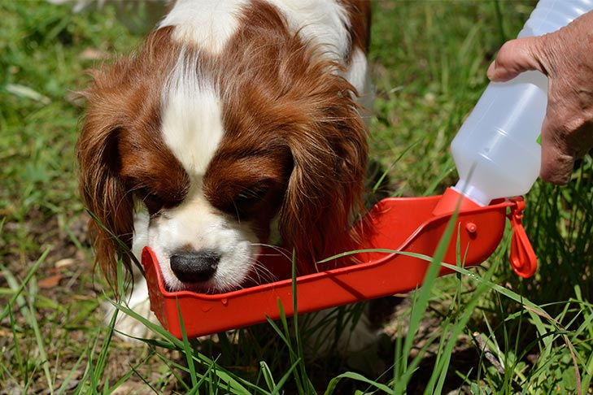
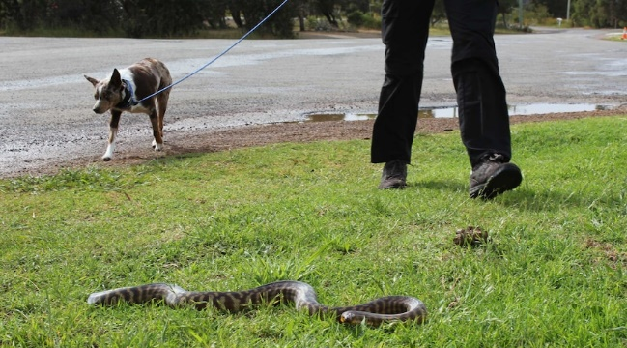
Other animals
Risks
Control/reduction/minimisation measures
Other dogs/compatibility issues, foxes, wildlife, snakes, spiders, infectious diseases/parasites etc
Considering compatibility of other dogs being walked at the same time/in same area
1 dog on walking track at a time policies
Being observant
No sharing of water stations/toys/equipment
Cleaning equipment between dogs
Washing hands/Alcohol Handrub between handling dogs

Slide 17
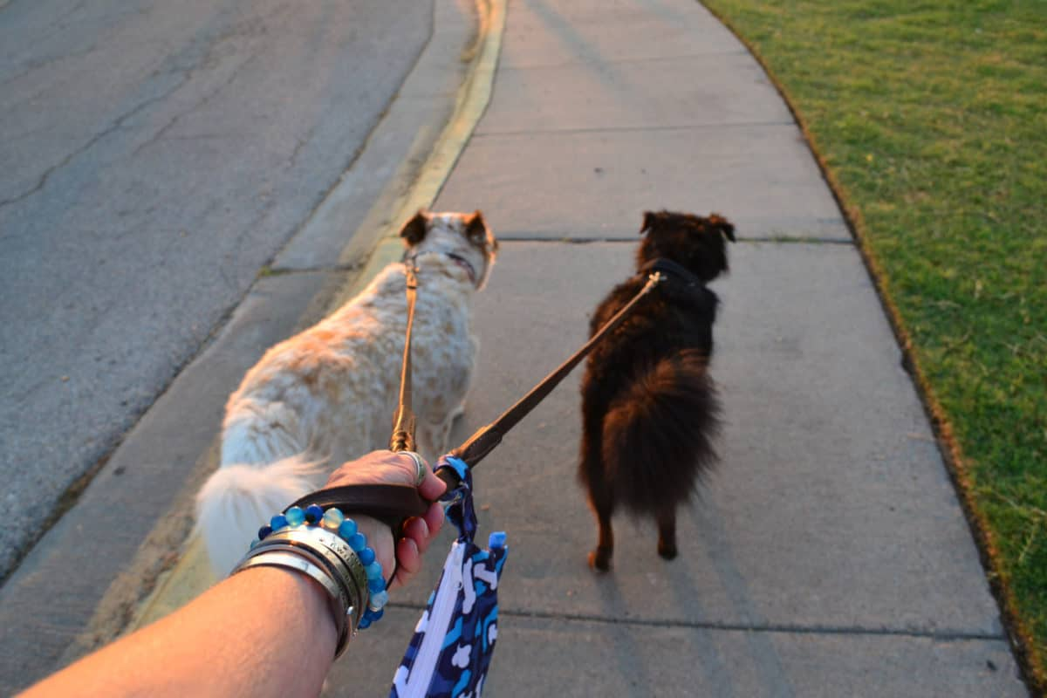
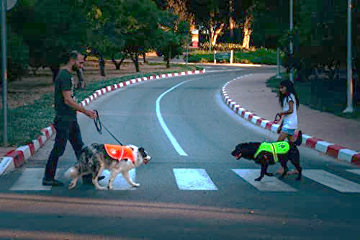
Cars/traffic
Risks
Control/reduction/minimisation measures
Getting run over/injured
Road safety
Wearing high vis external layer
Not walking a dusk/low light times if possible, choosing tracks with no/minimal road crossings

Slide 18
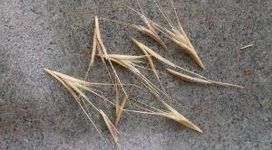
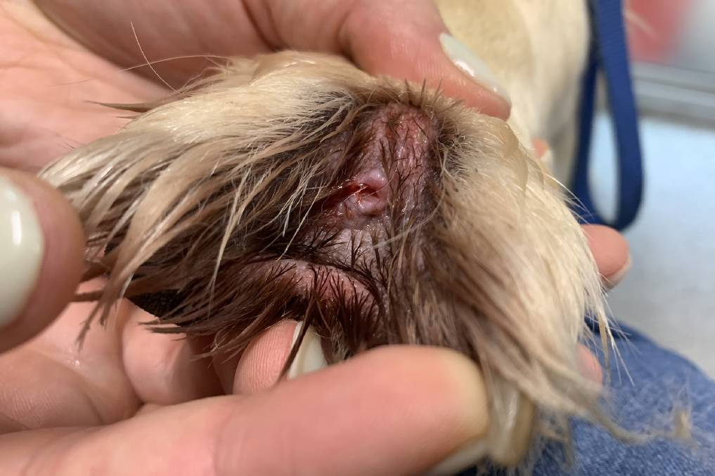
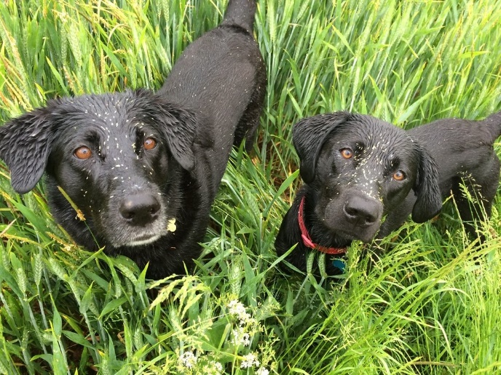
Terrain
Risks
Control/reduction/minimisation measures
Wet/slippery, long grass, grass seeds etc
Stay on set paths
Briefly check animal over after walk

Slide 19
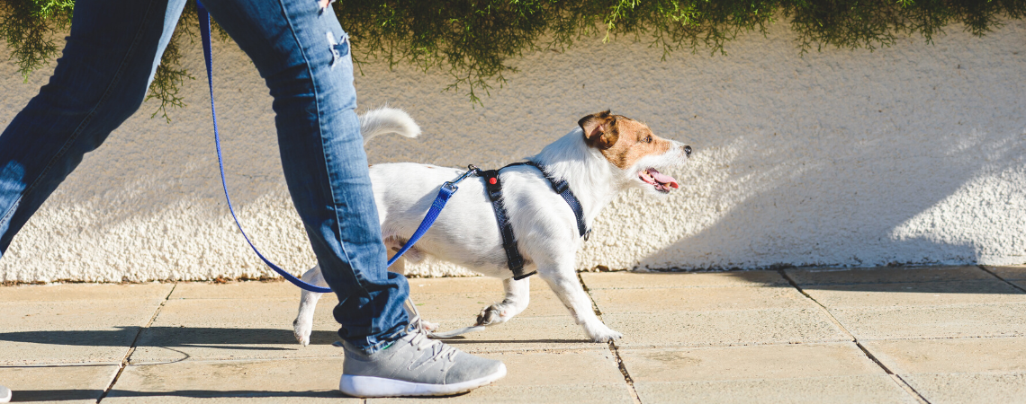
Environmental conditions
Risks
Control/reduction/minimisation measures
Wet, hot, cold, humid, stormy etc
Plan!
Check weather apps
Avoid walking on hot days/times

Slide 22
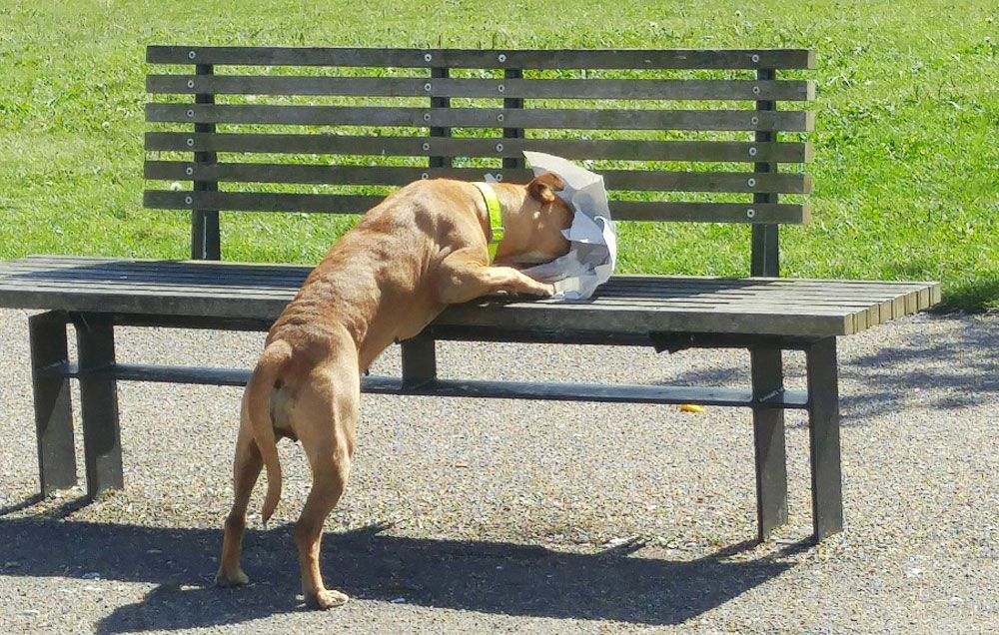
Toxic substances
Risks
Control/reduction/minimisation measures
Pesticides, poisons, litter, bait etc
Ingestion could cause anything from mild stomach issues to death
Be observant!
Stay on lead as much as possible, check off-lead areas prior to use.
Intervene quickly

Slide 23
Themselves! And Us!
Risks
Control/reduction/minimisation measures
Breed/type
Behaviour/body language
Infection transmission
Increased stress
Knowledge!
What is Brachycephalic Obstructive Airway Syndrome (BOAS)? – RSPCA Knowledgebase
The rest of this unit!
Cleaning up faeces immediately and disposing correctly

Slide 24
Some specific requirements of WHS legislation animal attendants must follow
Reporting-Reporting all hazards
Notifying- Notifying other of hazards
Hygiene- Adhering to infection control processes

Slide 25
Some specific requirements of WHS legislation animal attendants must follow
Reporting
Reporting all hazards
Notifying
Notifying others of hazards
Hygiene
Adhering to infection control processes
What would each of these look like in real life as an animal attendant when walking dogs?
Activity
Discuss in a group and come up with two scenarios for each.
Post your scenarios in the assigned StudentWeb Forum if this is a remote class.
Present your scenarios to the rest of the group if this is a face-to-face class.

Slide 26
Articles to read:
Safety When walking dogs:
https://studentweb.bhtafe.edu.au/mod/url/view.php?id=1571963
What are the risks to my dog from Rat Bait?
https://studentweb.bhtafe.edu.au/mod/url/view.php?id=1571965
Walking dogs safely guide
https://studentweb.bhtafe.edu.au/mod/resource/view.php?id=1571966
When taking your dog for a walk, beware of these hazards
https://studentweb.bhtafe.edu.au/mod/url/view.php?id=1571967
What do I need to know about Brachycephalic dogs?
https://studentweb.bhtafe.edu.au/mod/url/view.php?id=1571968
Dogs and garden/park dangers
https://studentweb.bhtafe.edu.au/mod/url/view.php?id=1571969

