Slide 1
ACMBEH301 ACMGEN303
Welfare and Behaviour Cluster
Session #7
INTRODUCTION TO DOG BODY LANGUAGE
ACMSPE301 Performance criteria: ACMGEN303 Performance criteria:
All referencing for copyright purposes is located within the Notes section of this resource.

Slide 2
Animal Behaviour
By changing their natural grouping we potentially subject the animals to stress
  Elephants – swaying
  Big cats - pacing
Or by removing them from their gregarious lifestyles they may become bored, anxious and panic.

Slide 3
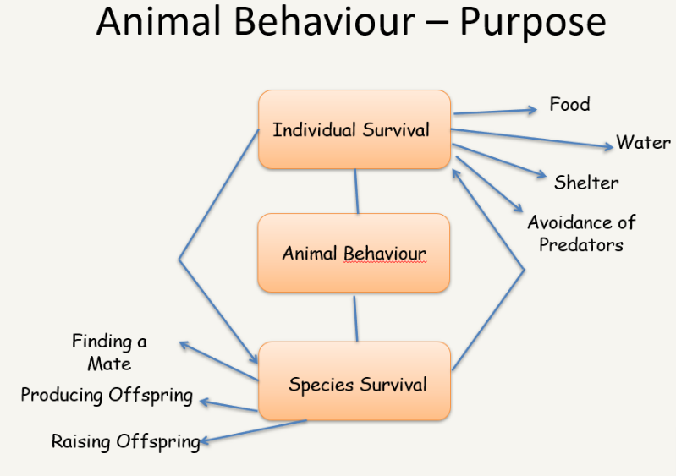

Slide 4

Where does behaviour come from?
Fight
Flight
Feeding
Reproductive behaviour
Freeze
Animals that fail to do these behaviours are outcompeted on an evolutionary level

Slide 5
What influences behaviour?
Domesticated
Breed-specific (bred by humans for traits/job roles as discussed previously)
Experience/Previous learning
Environment/The situation or scenario and context in question
Health (lifestyle factors and genetics/human breeding interventions)

Slide 6
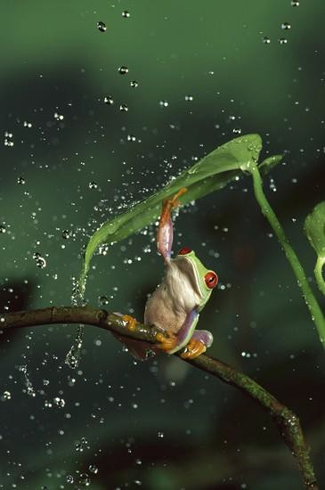
Behaviour – Big Picture
Why measure behaviour?
What is normal?
Identify abnormal behaviour
Identify behaviours associated with stress, pain, boredom
Help measure success of: enclosure design, enrichment
Determine best housing
Determine best handling/restraint
Reproductive Success

Slide 7
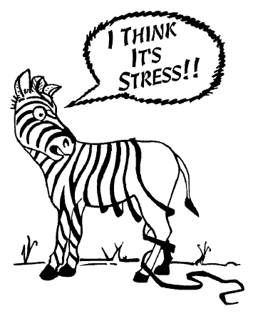
Animal Behaviour
Boredom and stress are the most common causes of behavioural problems
Stress in itself can cause disease or reduce immunity in the face of disease.
When physiological systems or internal chemistry is abnormal, behaviour may also become abnormal

Slide 8
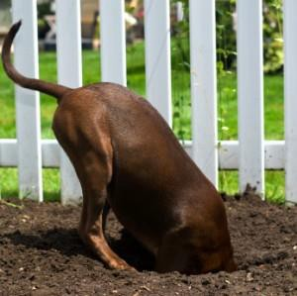
Animal Behaviour
Animals instinctive behaviours are still predominantly in line with their wild ancestors
Are instinctive behaviours that are elicited by human intervention really problem behaviours?

Slide 9
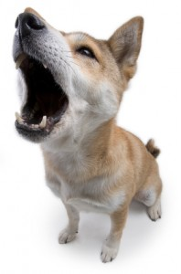
Species-specific animal behaviour - Dog
Eating
  Chewing
  Drinking
Barking
  Greeting
  Warning
Digging
  Storage
  Protection
  foraging
Aggression / Anxiety / Fear
Territory marking
Eliminating
Resting
Grooming
Social Play

Slide 10
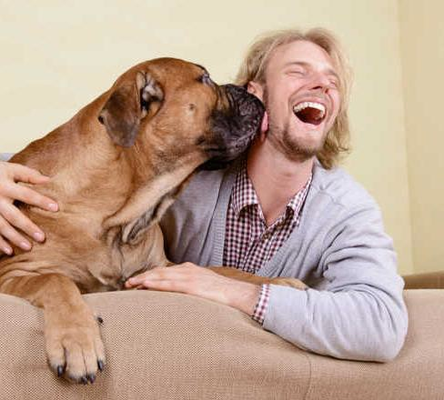
What are emotional Signals?
They are instinctive displays of body language triggered by the internal state of the animal
They are often subtle and by studying them you can gain valuable insight into how that animal might be feeling.
Similar to us crying, laughing, or blushing
Related to stress and aggression comfort/relaxation,

Slide 11
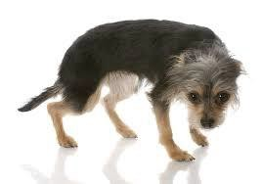
Why are they important?
Understanding emotional signals is valuable for preserving the animals well being.
Animals that are stressed often don’t learn well and fail to
remember what they
have been taught
Can help assess how well the animal is coping with handling
Whether handling errors, pain, confinement and medication causing stress

Slide 12
What to notice
By observing the
body parts of an animal and the context in which
they are being displayed can give you a good idea of
the emotional state
Ears
Mouth
Eyes
Head position
Tail
Overall body posture

Slide 13
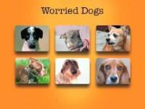
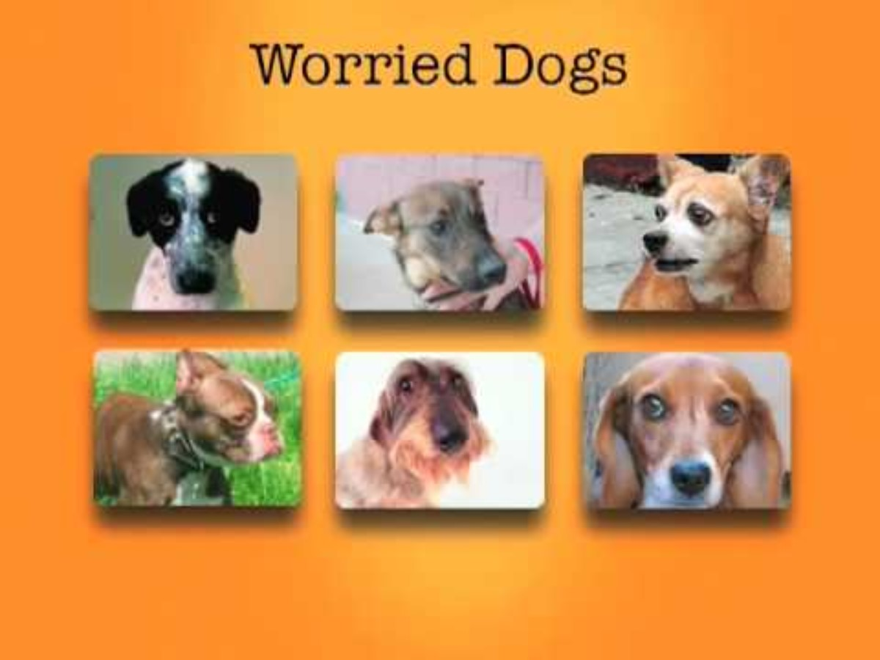
Body Language: Intro
First some videos....
Body language

Slide 14
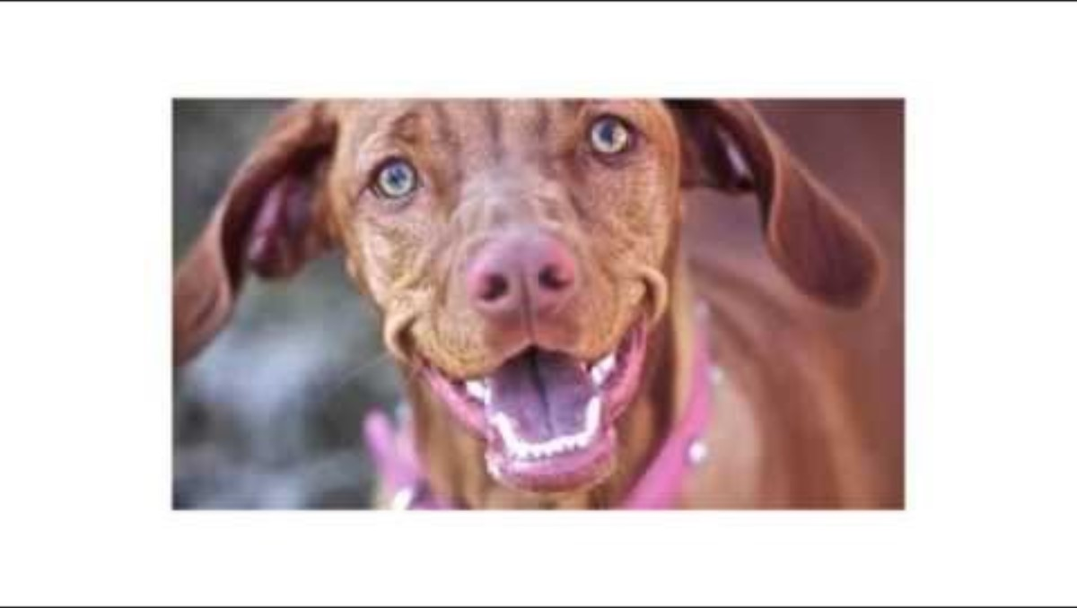
Body Language: Intro
First some videos....
Dog Body language – what your dog is desperately trying to tell you

Slide 15
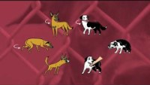
Body Language: Intro
First some videos....

Slide 16
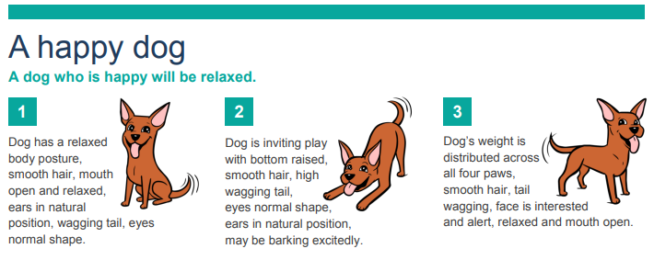

Slide 17
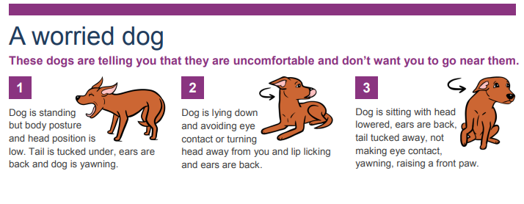

Slide 18
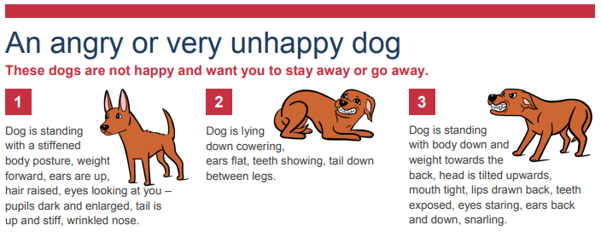

Slide 19
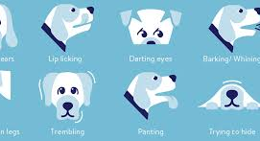
Body language of a stressed dog

Slide 20
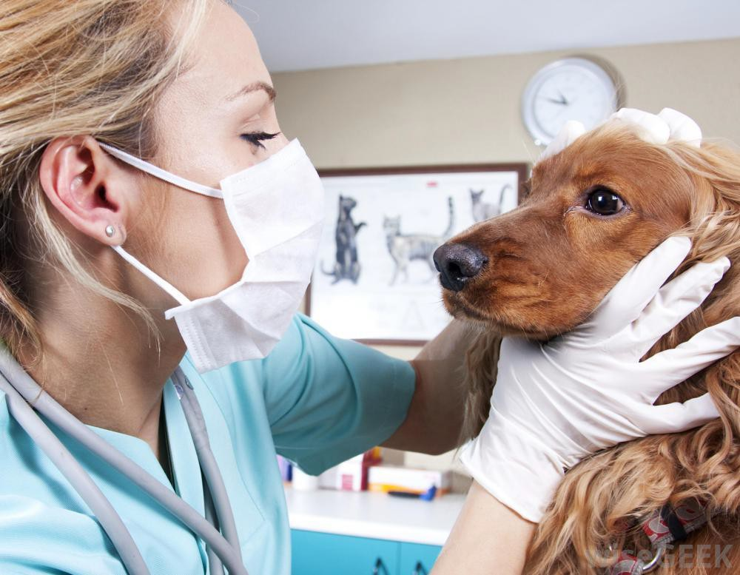
Causes of stress
Exposure to unfamiliar stimuli
Other dogs and people
Certain types of handling
Separation anxiety
Illness & medical
Lack of physical or mental exersise

Slide 21
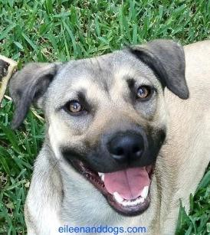
Body Language - Dog Signs of Relaxation / Comfort
Wriggly body posture
Attentiveness, seeking eye contact
An open mouth
Normal breathing or panting
Soft eyes
A loose wagging tail
Play bows
Normal ear carriage

Slide 22
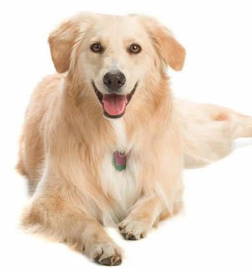
Signs of comfort
Resting on side
Loose and comfortable
Open mouth
Relaxed normal ear
Soft eyes
No worry frowns

Slide 23
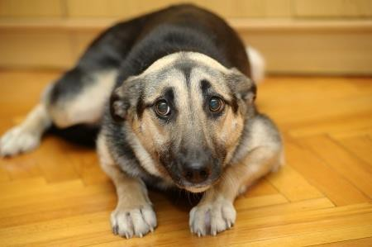
Signs of Stress - Head
Whale eye
Ears back or flat against head
Excessive drool
Lip licking
Mouth closes suddenly
Rapid panting
A stressed dog that is not panting is more dangerous
– no mechanism to relieve and more likely to react

Slide 24
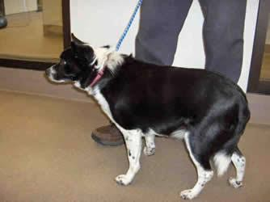
Signs of Stress - Tail
Tucked under body
Slow tentative wag
Straighten out
Held low – if normal carriage is set high

Slide 25
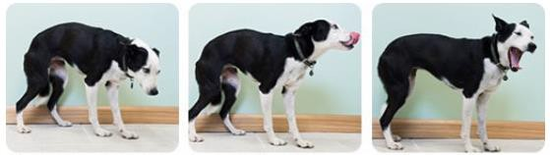
Body posture
Hunched, lowered head, lip licking, yawning Trembling, pacing, freezing, stiffness, exposing belly, urinating, panting, hiding, ears pinned, vocalisation, drooling, foaming, dilated pupils whale eye

Slide 26
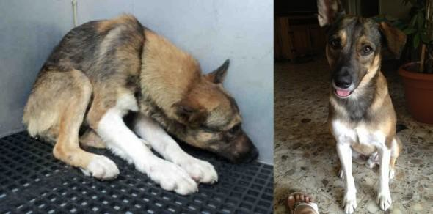
Avoidance behaviours
Turning head away
Backing away
Hiding

Slide 27
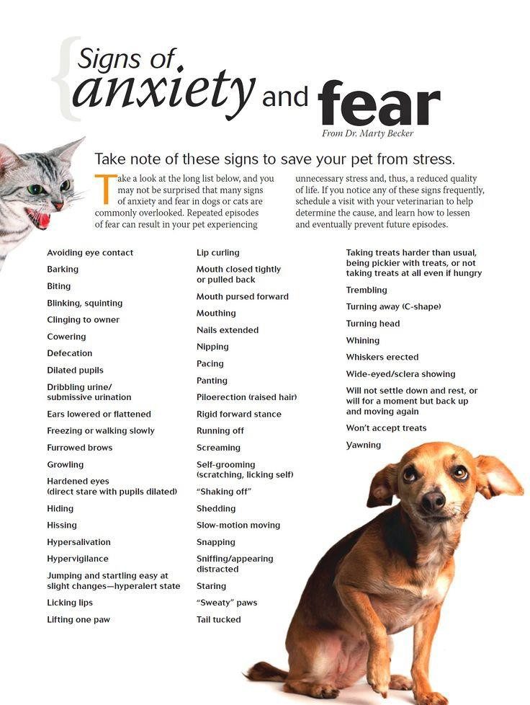
Displacement Behaviours
Scratching
Lip licking
Sneezing
Yawning
Blinking
Turning away
Sniffing the ground
Shaking off when dry

Slide 28
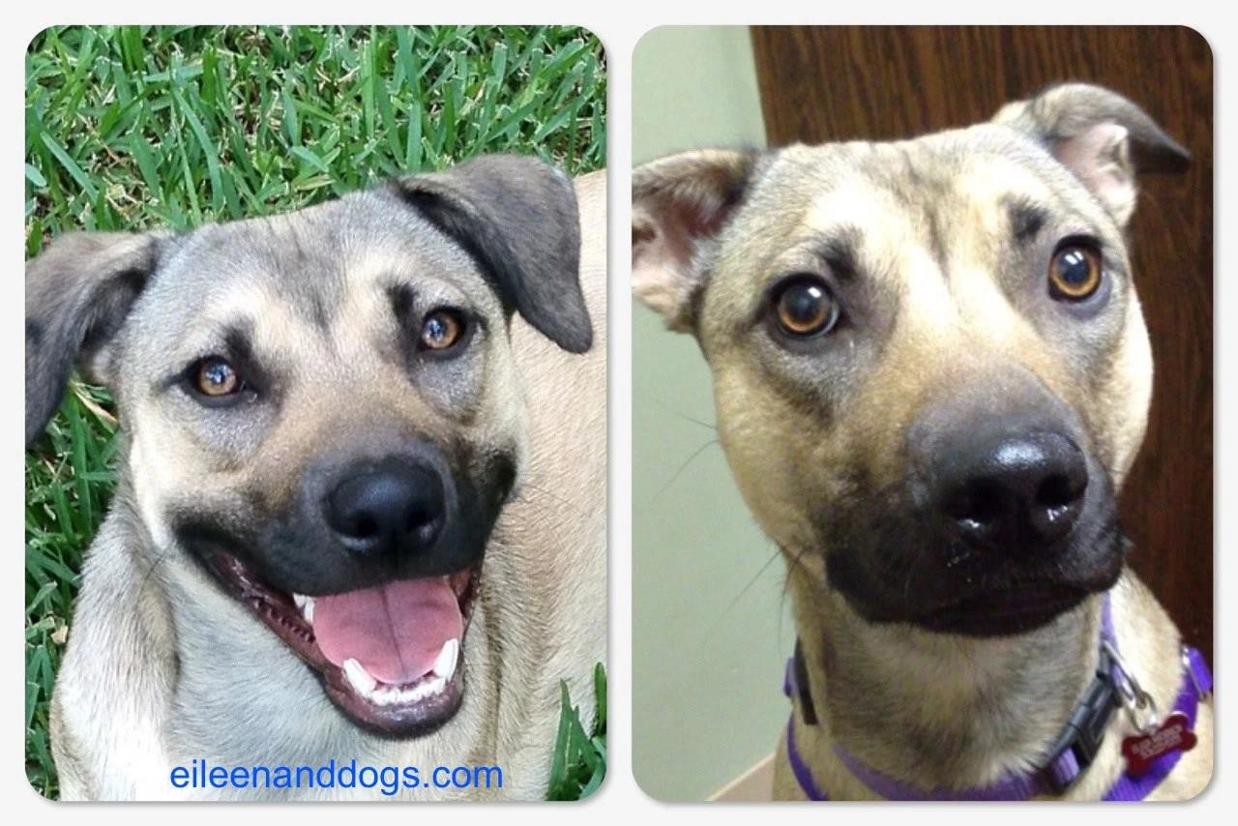
Same dog

Slide 29
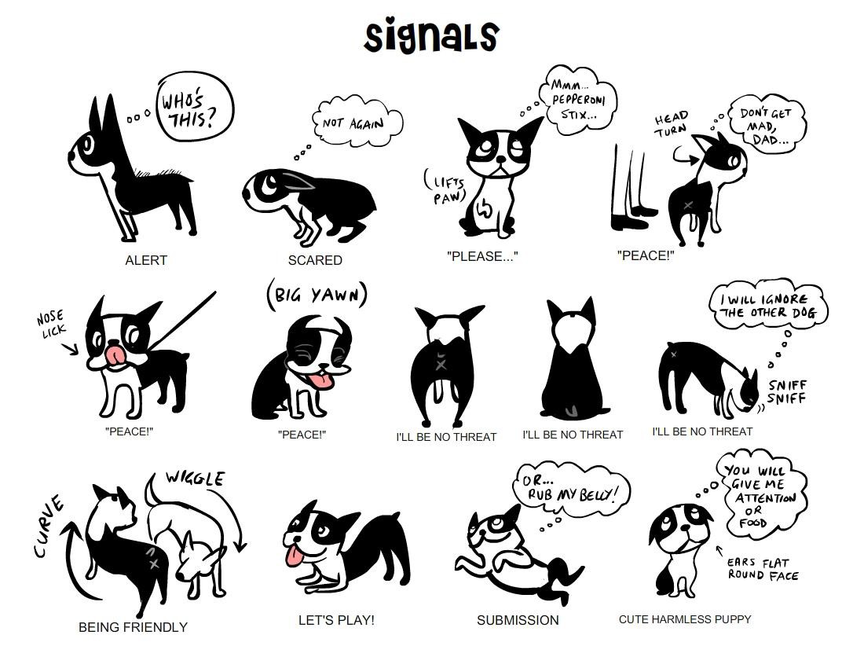
Body language Signals

Slide 30
Doggie Language – Class Activity
Using the worksheets provided in the shell, try to place all the behaviours to the correct photo (alternatively label them
happy/unhappy/stressed etc)
*READY(PREY BOW) *SUSPICIOUS *FRIENDLY *HAPPY(OR HOT)
*ANXIOUS *HELLO I LOVE YOU(GREETING STRETCH) *STALKING
*ANGRY *PEACE!(LOOK AWAY/HEAD TURN) *YOU WILL FEED ME
*STRESSED(NOSE LICK) *I’M YOUR LOVEBUG(BELLY RUB POSE)
*STRESS RELEASE(SHAKE OFF) *ALERT *PEACE!(SNIFF GROUND)
*PRETTY PLEASE(ROUND PUPPY FACE)
*RESPECT(TURN AND WALK AWAY)
*CURIOUS(HEAD TILT)
*STRESSED(SCRATCHING)
*OVERJOYED(WIGGLY)
*I’M FRIENDLY(PLAY BOW)
*MMMM… *RESPECT(OFFER BACK)
*RELAXED(SOFT EARS,BLINKY EYES)
*FRIENDLY AND POLITE(CURVED BODY) *I LOVE YOU, DON’T STOP
*NEED SPACE(WHALE EYE) *THREATENED *STRESSED(YAWN)

Slide 31

Speaking Dog! Canine Communication #1 of 3
Watch the recording
  You may need to register first
Attendees will:
Assess behaviour based on dog’s eyes, ears, mouth, tail, and weight distribution
Correctly identify the many labels attributed to shelter dogs
Understand how to conduct more informative assessments and better matchmaking

Slide 32
Homework
Please complete the following video and questionnaire (approx. 30 minutes):
https://studentweb.bhtafe.edu.au/mod/quiz/view.php?id=1571980
Please read the following links on student web under the tab ‘dog behaviour and body language:
Dog behaviours explained | Vet Voice
Body language in dogs
Body language of fear in dogs
And complete the following quiz:
Online Activity: Body LanguageQuiz

