Slide 1
The welfare, behaviour, and exercising dogs Cluster ACMGEN303 - Assess the welfare status of an animal ACMBEH301 - Identify behaviours and interact safely with animals ACMGEN308 - Walk and exercise dogs
Session #9
All referencing for copyright purposes is located within the Notes section of this resource.
This resources covers the following performance criteria:
ACMGEN303: None
ACMBEH301: 1.5
ACMGEN308: 2.1, 2.3, 2.4, 2.5, 3.1

Slide 2
How did your Dog Park Activity go? What did you learn in video 2 of Canine Communication - speaking dog?

Slide 3
Logging behaviours when you see them

Slide 4
Using the FAS Scale
Traffic light system for emotional state/arousal level of the dog
Green = positive/neutral, moving to yellow/red indicates negative state
Core assessment: Neutral v positive v negative
Then score FAS and colour
Assess behaviour and body language and match to the score out of 5 + colour

Slide 6
FAS Scoring GREEN

Slide 7
FAS Scoring YELLOW

Slide 8
FAS Scoring RED

Slide 10
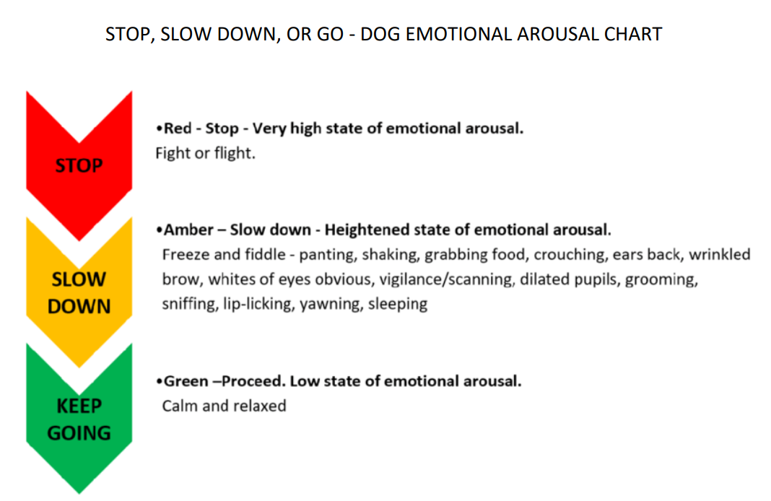

Slide 11
Objective vs Subjective

Slide 12
Objective vs Subjective

Slide 14
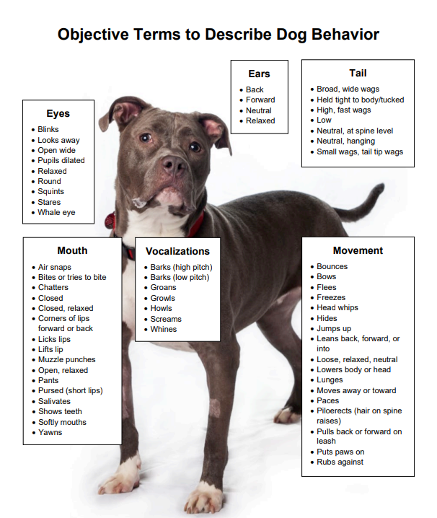

Slide 15
Make some suggestions for how to improve the emotional state of the dogs in the next slides using objective language

Slide 16
Tyla loves his walk TO the park, but once he gets there he stays like this behind his dog walker’s legs the whole time, what advice could you give his owner?

Slide 17
Lenny the JRT LOVES other dogs. Julia is quite shy. Their human parents are new work friends and today is the first time the dogs have been on a walk together. What would you say to the owners?

Slide 18
It’s Lola’s first day at Doggy Day Care, she was reluctant to go near the other dogs and slinked away from touch. What would you tell her owner about how she interacted that day?

Slide 19
Walking and exercising dogs

Slide 20
Before you walk
Confirm the task, time, duration
Establish the walking route
Discuss questions with supervisor
In shelters and kennels dogs should get exercised between 30minutes to 2 hours per day

Slide 21
Then:
Organise dog-walking equipment
Waste bags
Water supply
Treats/toys
Other as needed (ie high vis jacket)
Lead/collar/other

Slide 22
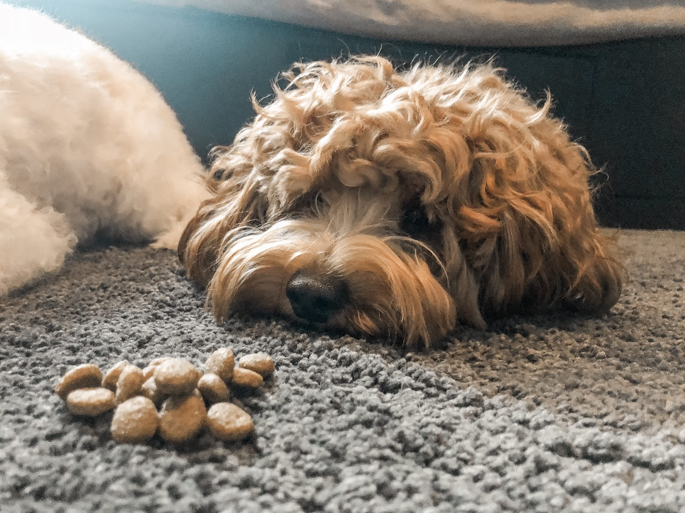
Can only organise treats, toy, lead/harness/collar once you identify which dog you are assigned
Allergies
Sizing
Preferences

Slide 23
Behaviour observation log

Slide 24
Identifying the dog

Slide 25
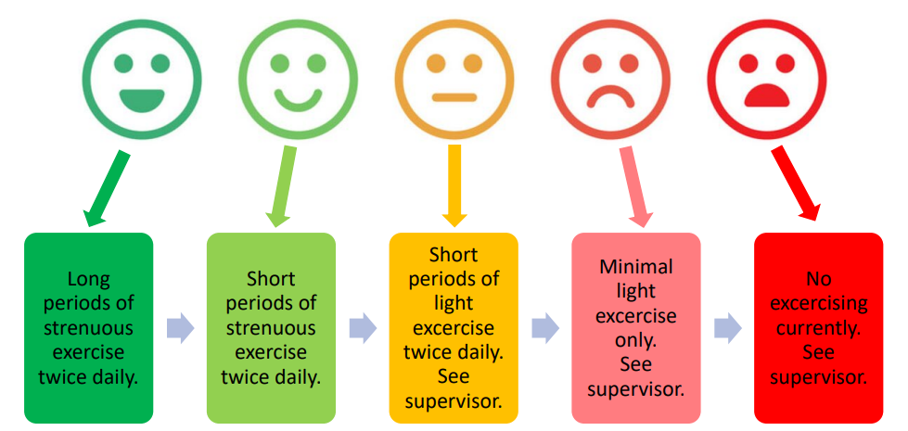
Checking health and physical capability/fitness status for grooming
What factors might come in to this assessment? How might you determine physical capability in regards to grooming?

Slide 26
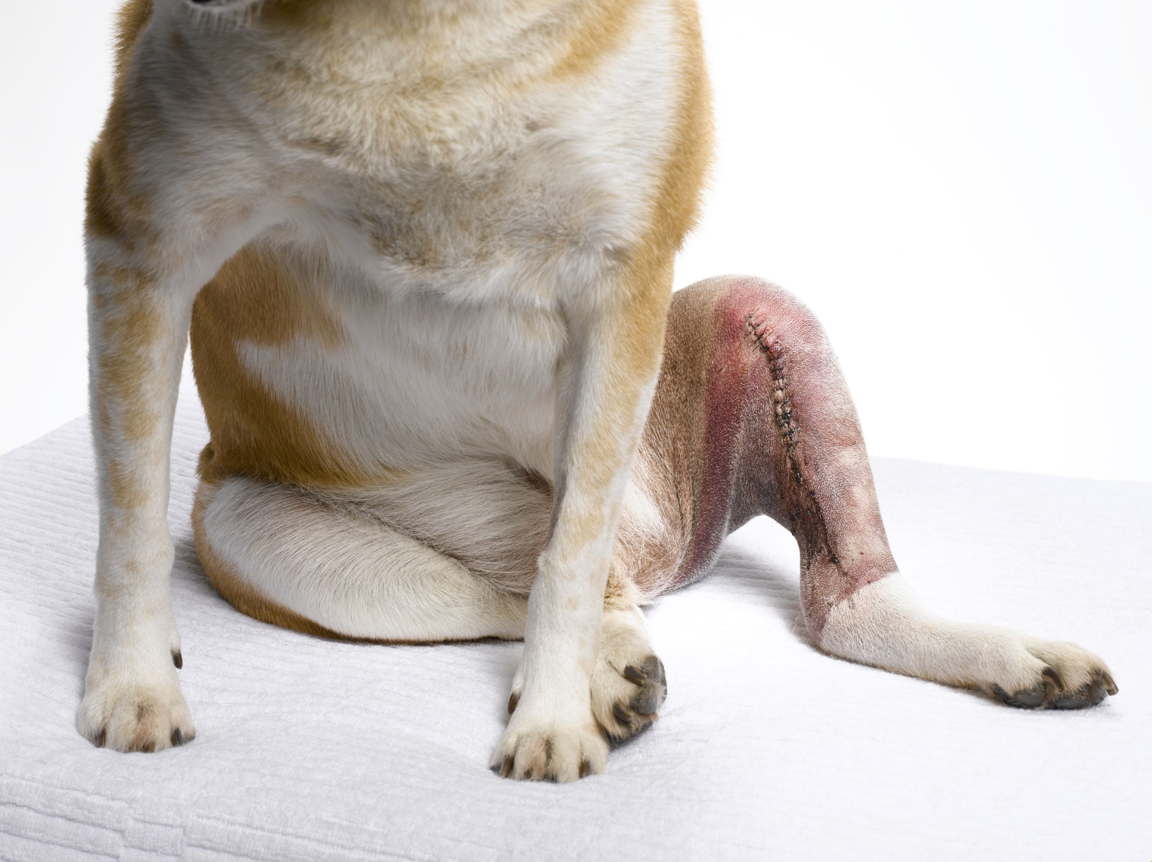

Slide 27
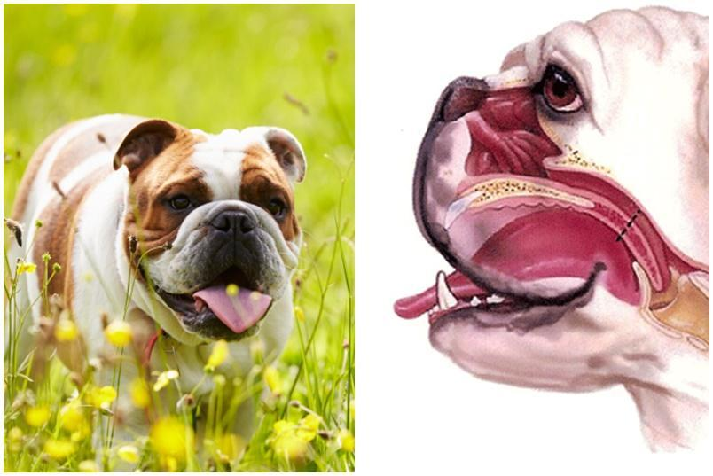

Slide 29
What physical capabilities would differ here?

Slide 30
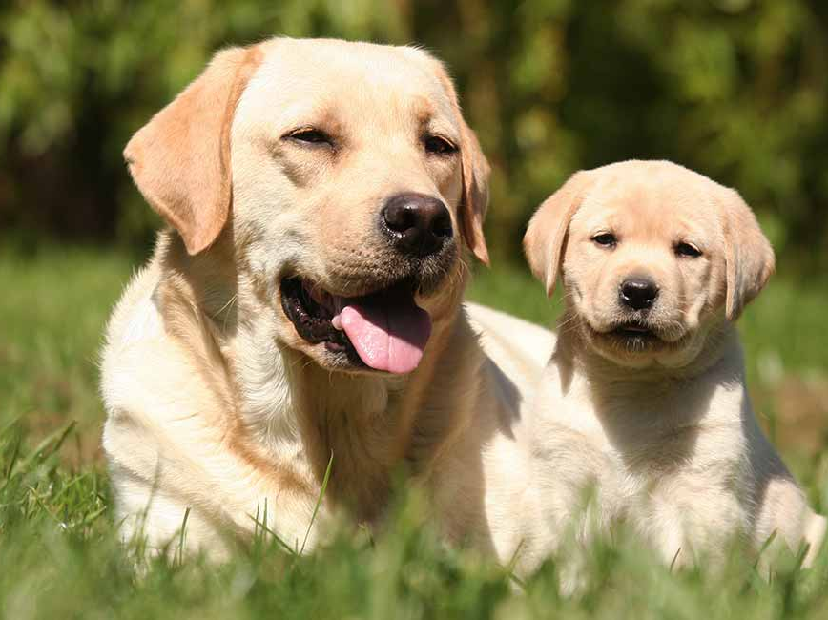

Slide 31
Important to assess prior to walk

Slide 32
How to Interact with Dogs to Minimize Stress
Online Courses from the ASPCA Learning Lab | ASPCApro (20 mins)
Upload your completion transcript on studentweb
Please complete before next weeks session

Slide 33
Homework
Complete the ‘how to interact with dogs to minimise stress’ course
Watch the recording for video #3/3

