Slide 1
The welfare, behaviour, and exercising dogs Cluster ACMGEN303 - Assess the welfare status of an animal ACMBEH301 - Identify behaviours and interact safely with animals ACMGEN308 - Walk and exercise dogs
Session #10
All referencing for copyright purposes is located within the Notes section of this resource.
This resources covers the following performance criteria:
ACMGEN303: None
ACMBEH301: 2.5, 3.2, 3.3, 3.4, 3.5, 4.2, 4.4, 4.5, 4.6
ACMGEN308: 2.5, 2.6, 2.8, 3.2, 3.3, 3.4, 4.1, 4.2, 4.3, 4.4

Slide 2
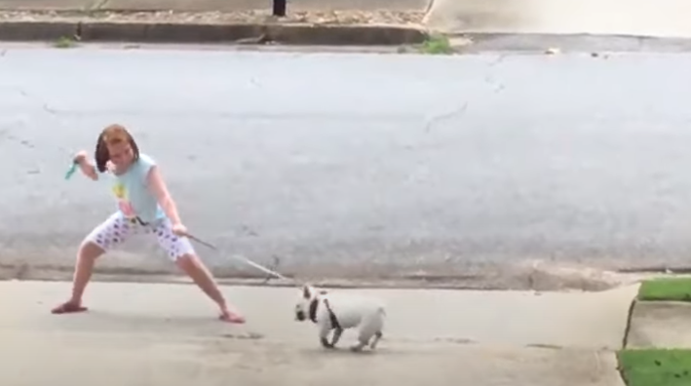
Things that can go wrong walking dogs
https://www.youtube.com/watch?v=id2NJ_v41jo
This video is meant to be for laughs, but I want you all to rewatch it later and comment on what you could do differently to make one of these situations safer and better for the dog.

Slide 3
Before you walk
Confirm the task, time, duration
Establish the walking route
Discuss questions with supervisor

Slide 4
Identifying the dog
What are some ways to identify dogs before we take them out for a walk?

Slide 5
How to walk a dog

Slide 6
“Heel”

Slide 7
Based on:

Slide 8
Loose leash, positive experience, focus on handler when needed

Slide 9
Walking calmly on a loose lead

Slide 10
Better loose leash walking

Slide 11
Positive reinforcements
Always remember positive reinforcements:
Treats/toys
Verbal praise
Patting
Clicker training
What is motivating for one dog may be different to another so ensure you have a bag of tricks to work with

Slide 12
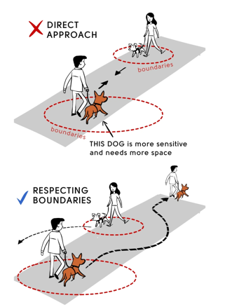
Space Etiquette for dogs booklet

Slide 13
How to make your dogs walk great for both of you the fear free way.

Slide 14
Equipment for walking dogs

Slide 15
Basic anatomy

Slide 17
Choosing and using Dog collars, Harnesses and leashes the Fear Free way

Slide 18
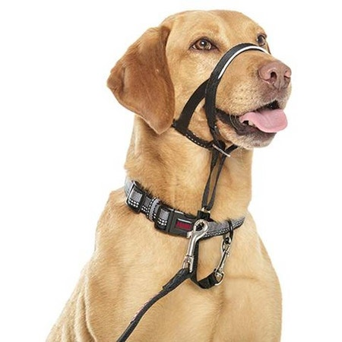
Why do we not recommend these for all dogs?

Slide 19
In shelter:
How to use a Slip Lead- with Steve from Pack Leader Dogs
Sometimes no “stopper”
We don’t walk dogs on the right – “heel” is left, as is the Australian way
This is used unless a behaviourist identifies a need for an alternate piece of equipment

Slide 20
How to use a slip lead

Slide 21
On the walk

Slide 22
Post-exercise
Quick health check
Not too over-exerted?
Grass seeds
General FAS score

Slide 23
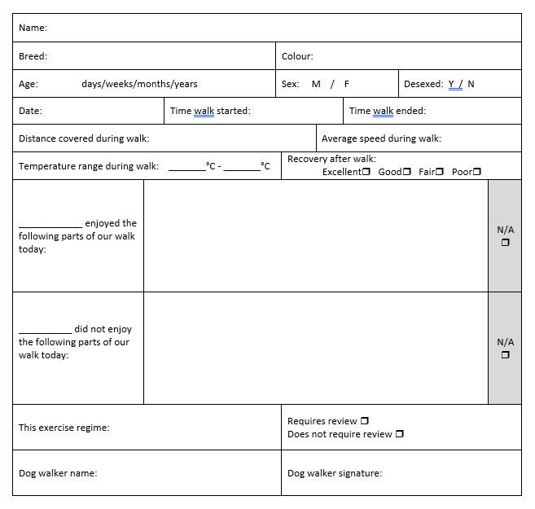
Post-exercise
Log the specifics!

Slide 24
Post-exercise
Handy hygiene
Clean, sanitise, and store the equipment used
Where can you find safety information about cleaning products?

