Slide 1
The welfare, behaviour, and exercising dogs Cluster
ACMGEN303 - Assess the welfare status of an animal
ACMBEH301 - Identify behaviours and interact safely with animals
ACMGEN308 - Walk and exercise dogs
Session #11
All referencing for copyright purposes is located within the Notes section of this resource.
This resources covers the following performance criteria:
ACMGEN303: None
ACMBEH301: 2.5, 3.2, 3.3, 3.4, 3.5, 4.2, 4.4, 4.5, 4.6
ACMGEN308: 2.5, 2.6, 2.8, 3.2, 3.3, 3.4, 4.1, 4.2, 4.3, 4.4

Slide 2
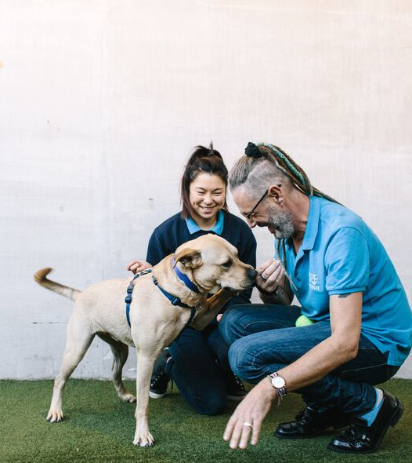
Every dog has a different way of responding to people. Just like us humans, some dogs are more extroverted, while others can be shy and nervous.
https://www.battersea.org.uk/pet-advice/dog-care-advice/how-approach-dog#:~:text=Allow%20the%20dog%20to%20approach,chin%2C%20which%20most%20dogs%20enjoy.

Slide 3
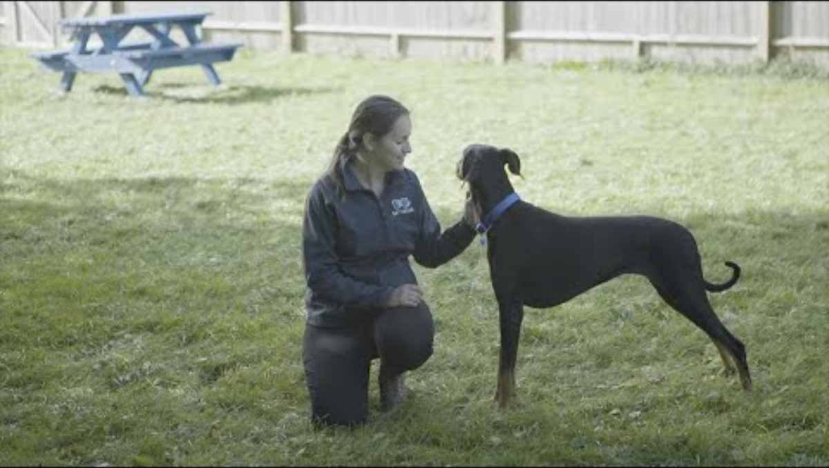
https://www.youtube.com/watch?v=N_C9CzoCZ9I

Slide 4

https://www.youtube.com/watch?v=Bu1n1mPCCOo&t=110s

Slide 5
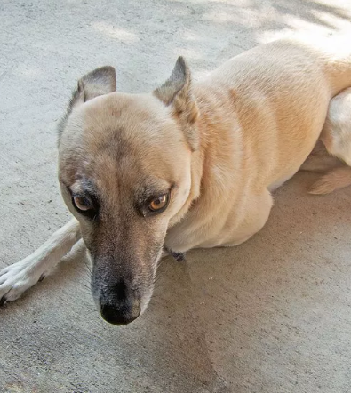
Not every dog wants to be your friend
Read the dogs body language!
If they are tense, their tail between their legs, growling it is better to keep your distance
Notes:
If you must approach an unfamiliar or unknown dog, the best way to do so is with your hands flat and your palm facing upward. And when you get close, don’t put your hand above the dog’s face or head. This action can be triggering for some dogs and can make them bite or attack the person.
Instead, reach to the side of the dog’s face, under the chin or the shoulder. These gestures communicate to the dog that you’re being friendly. This is in contrast to the palm down approach that many people practice.
Many of the 4.5 million dog bite victims in the United States typically try to pat a dog’s face or head. So, avoid patting gestures and be extra careful when approaching an unfamiliar dog.

Slide 6
Watch for appeasement gestures
A dog bite is more likely if a dog is scared and feels like they can't run away, and unfortunately, when they are on a leash, they simply can't escape. While the dog owner holds the most responsibility for not forcing their dog into uncomfortable situations, those of us who love dogs and just want to say hello can help set these dogs up for success.

Slide 7
Signs a dog may want to be left alone
Tucked tail
Lip-licking
Avoiding eye contact
Whale eyes
Ears pulled back
Body weight shifted back
Creases at corner of mouth
Furrowed brows
Lowered head
Body in slight crouch

Slide 8
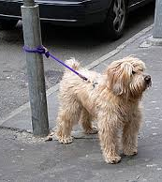
How to APPROACH and greet a dog
Ask permission from the dogs owner before interacting
Never approach a dog if the owner is not present or if the dog is tied up

Slide 9
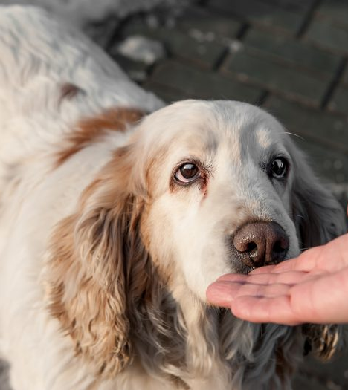
Don't bother with the hand-sniff
Do NOT offer your hand to be sniffed!
INSTEAD, stand with your side facing the dog.
Avoid eye contact and let them come to you
While common advice is to extend your hand out for the dog to sniff, even this can cause some dogs to shy away or trigger a defensive bite if the movement startles them. A dog's sense of smell is amazing — they can smell you just fine from a few feet away without your hand in their space.

Slide 10
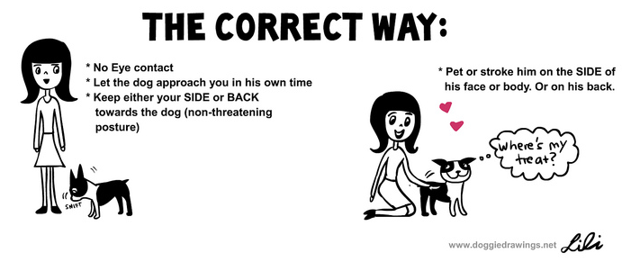
Do not make sudden movements

Slide 11
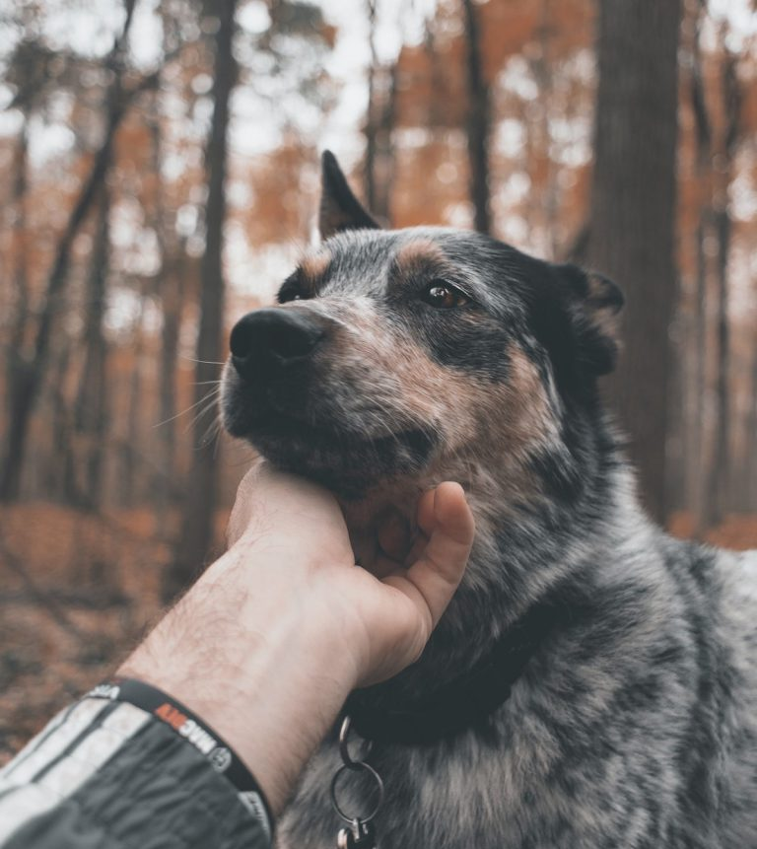
Indicate that you are friendly...
Do not make high pitched noises
Greet the dog in normal calm tone of voice
Have your palm facing up next to your body
Reach for the side of the dogs face, under the chin or the shoulder

Slide 12
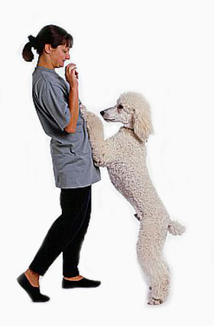
What if they jump up?
If the dog continues to jump up, then turn away and fold your arms.
Back off and wait
Toss a treat behind the dog to get it away from you
Ask the dog to "Sit"
Reinforce four paws on the floor
Reinforce a bottom on the floor

Slide 13
Small dogs
Crouch down to the dog’s level. Always have one foot flat on the ground so you’re able to quickly get up if needed.
Avoid bending over the dog – frightening and threatening
the overhead dread
Squat down if you can
Rub their chest and shoulders first

Slide 14
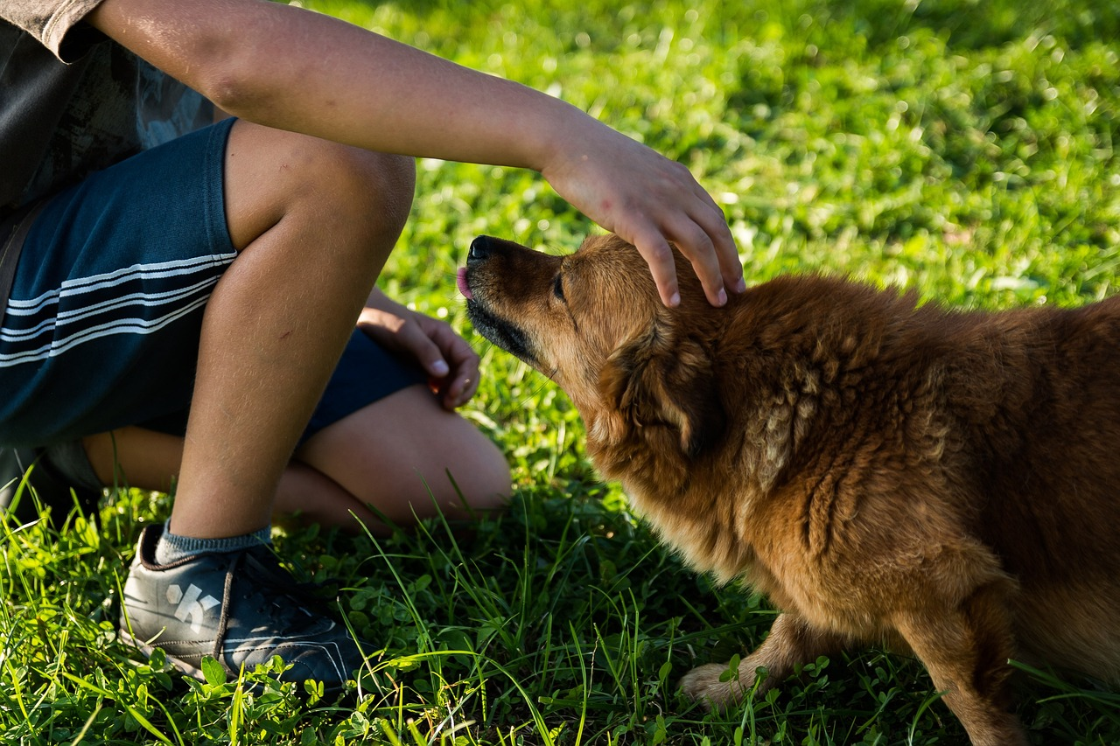

Slide 15
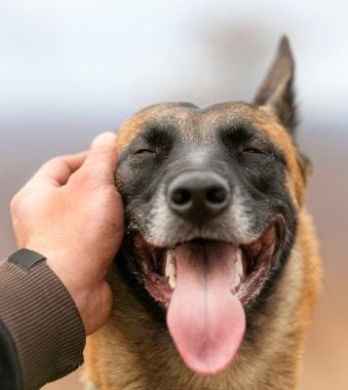
Large dogs
For a larger dog approach side on with your hands by your side and encourage the dog towards you if they are comfortable
Touch side of face, neck and shoulder

Slide 16
Don't overdo it......
After stroking the dog for a few seconds, gently move your hand away. If the dog wants more, they will lean into you or nudge you for more. If they don’t want any more attention, that’s OK too, as listening to the signs the dog showed will have given them a positive experience when meeting new people.

Slide 17
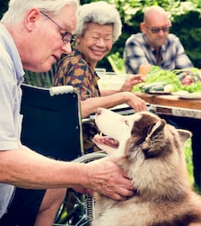
A happy dog wanting to be touched
An open mouth
Relaxed ears
"Soft" eyes
Loose body with a loose wagging tail
Will approach you for interaction, leaning on you or seeking out touch

Slide 18
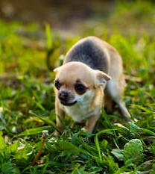
A dog who is unsure about being petted - review
Closed mouth
Lip licking
Obvious blinking
Turning their head away
Ears pinned back against their head
Wide eyes with the whites showing
Trying to back away from you or hide

Slide 19
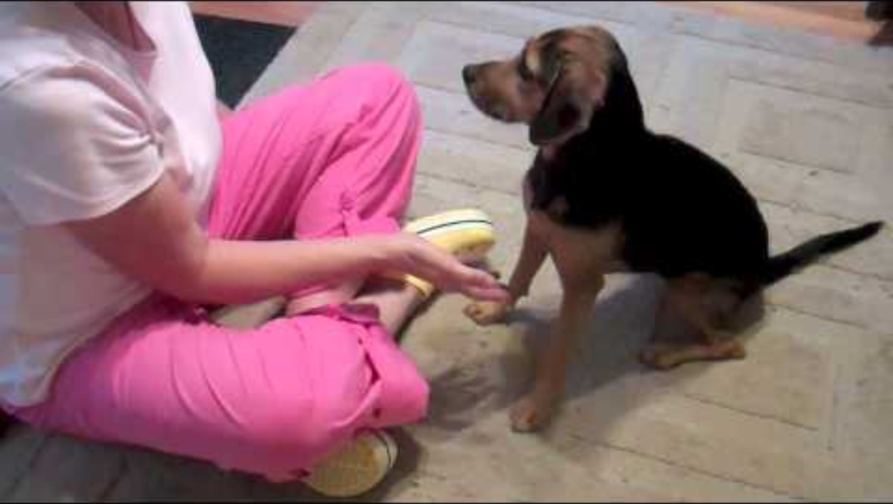
Does your dog REALLY want to be petted?
https://www.youtube.com/watch?v=-cGDYI-s-cQ

Slide 20
How to walk a dog

Slide 21
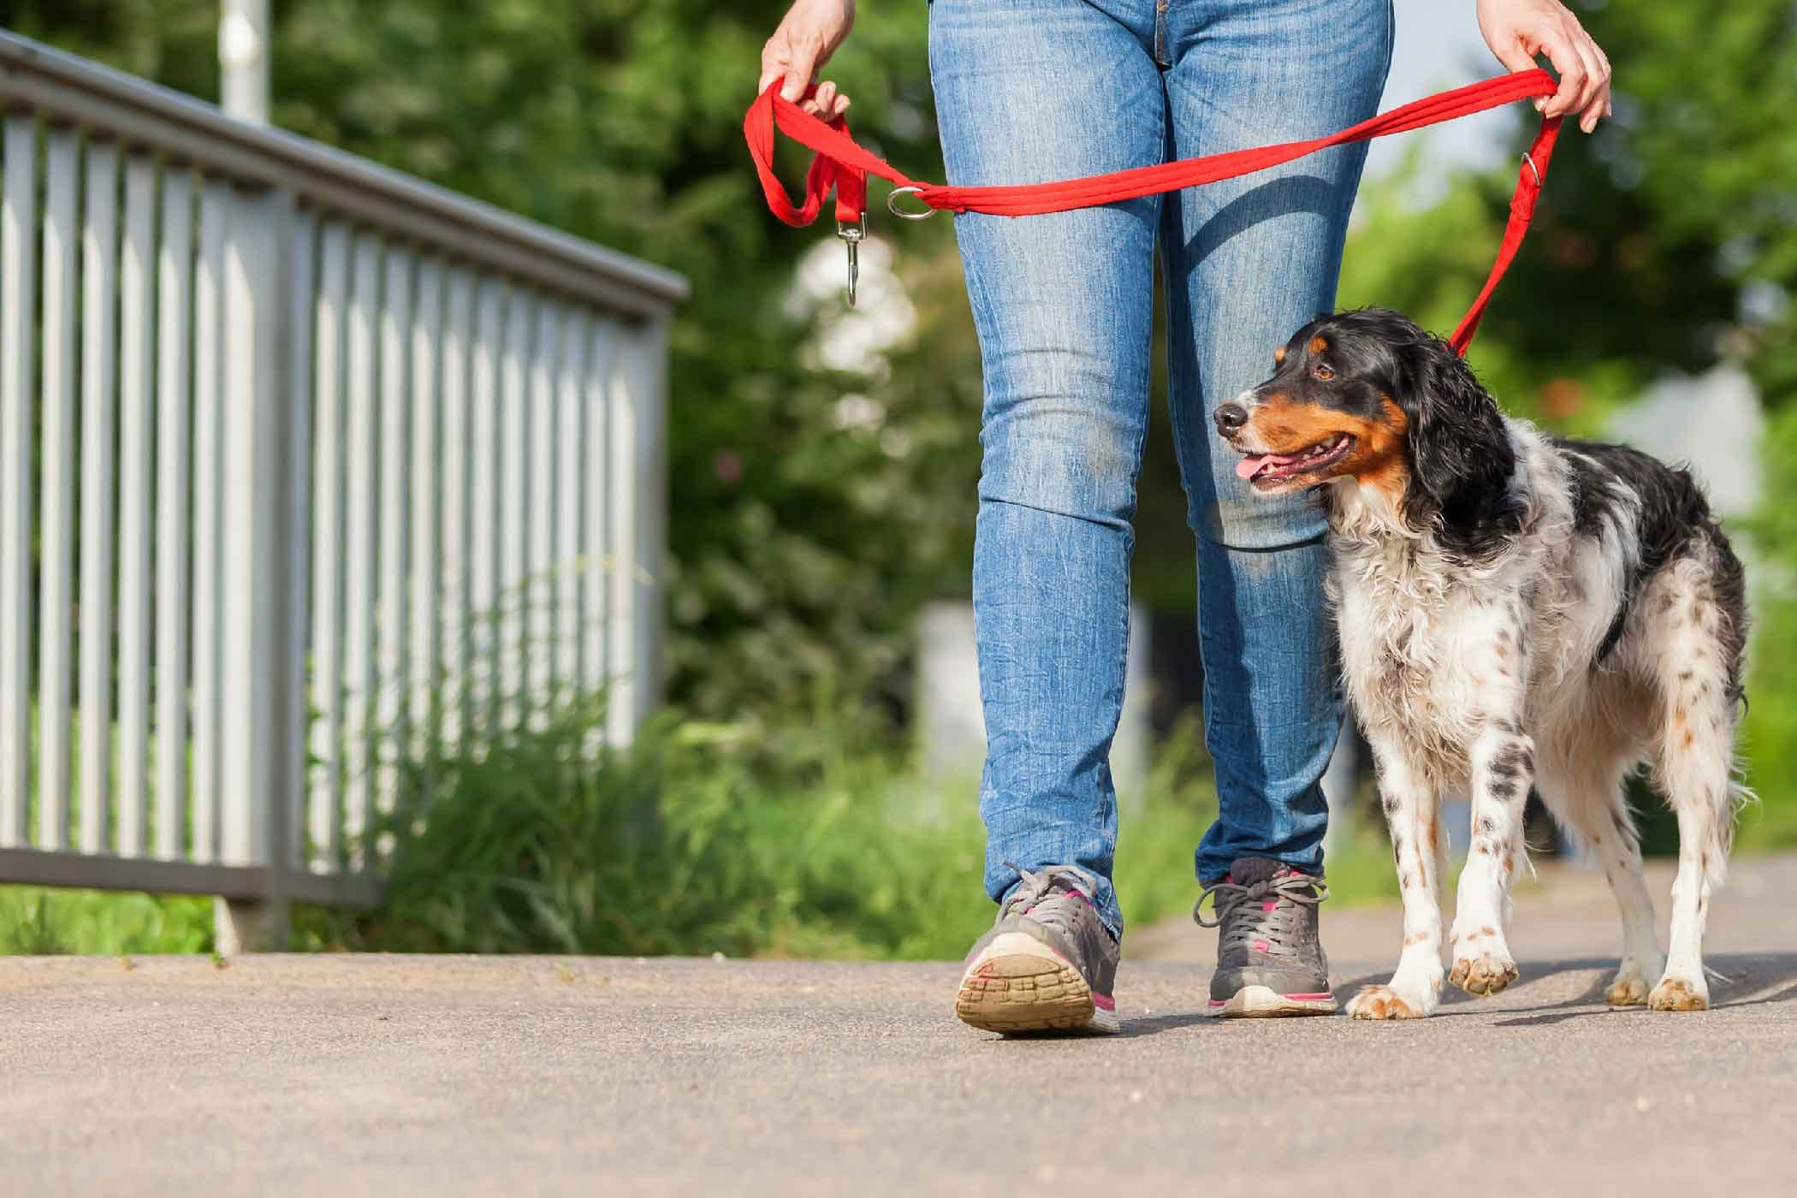
“Heel”

Slide 22
Army Training - obedience
Exercises in teaching obedience for military exercises
Police work
Dogs that bark – sentry
Tenacious – the drive to seek – scent
Attack & defence – only bite on command
Now use positive & reward based training.

Slide 23
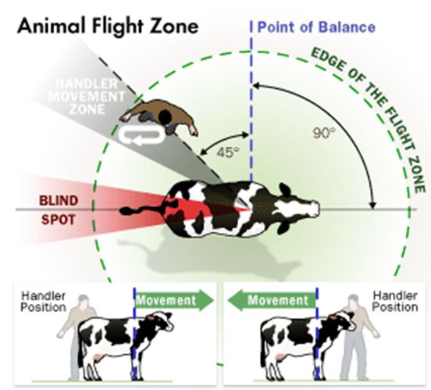
Based on:

Slide 24
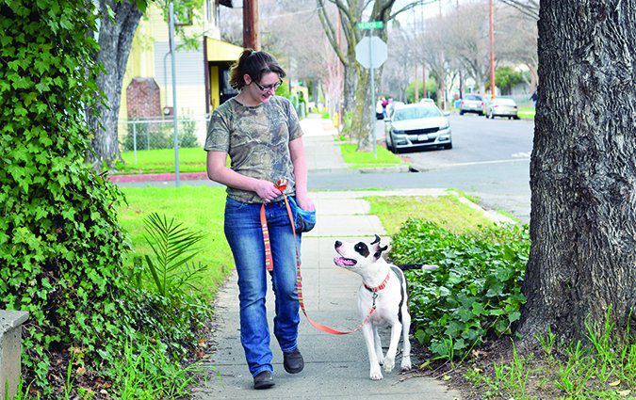
Loose leash, positive experience, focus on handler when needed

Slide 25
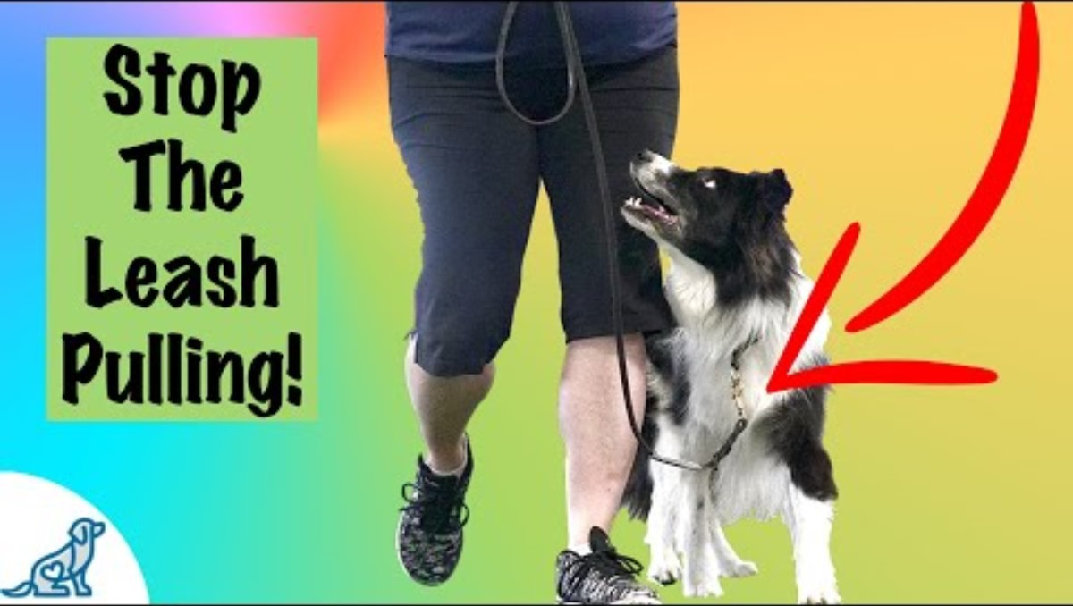
Walking calmly on a loose lead

Slide 26
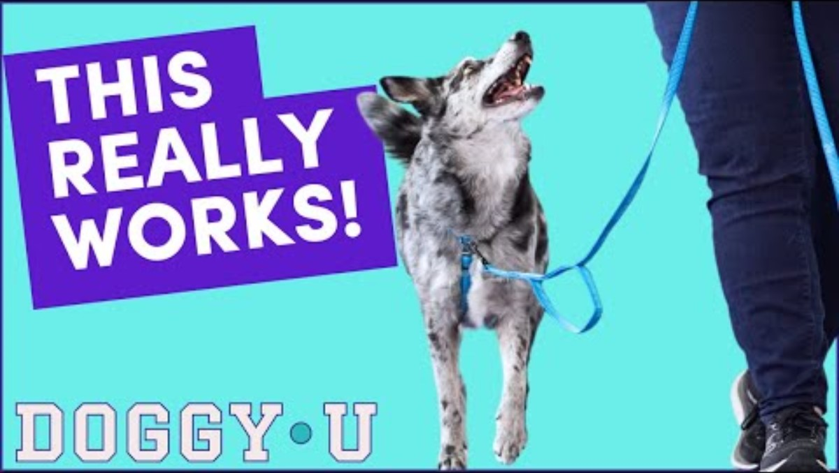
Better loose leash walking

Slide 27
Positive reinforcements
Always remember positive reinforcements:
Treats/toys
Verbal praise
Patting
Clicker training
What is motivating for one dog may be different to another so ensure you have a bag of tricks to work with

Slide 28
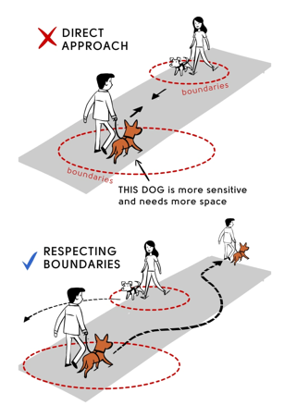
Space Etiquette for dogs booklet

Slide 29
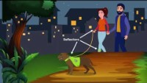
How to make your dogs walk great for both of you the fear free way.

Slide 30
How to Make Your Dog’s Walk Great for Both of You

Slide 31
Equipment for walking dogs

Slide 32
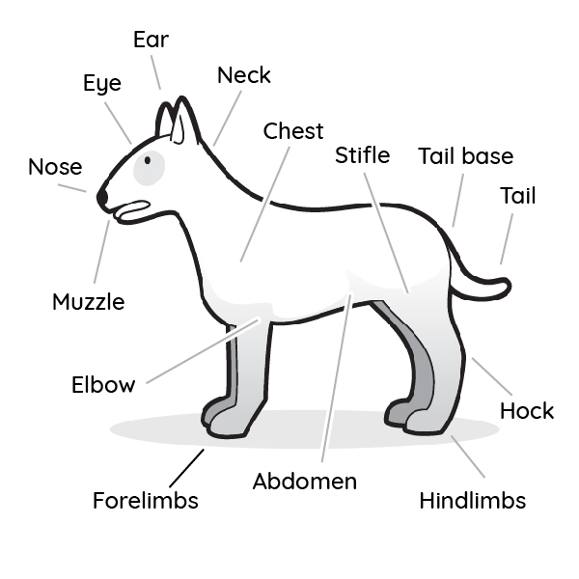
Basic anatomy

Slide 33
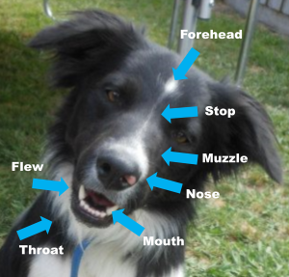

Slide 34
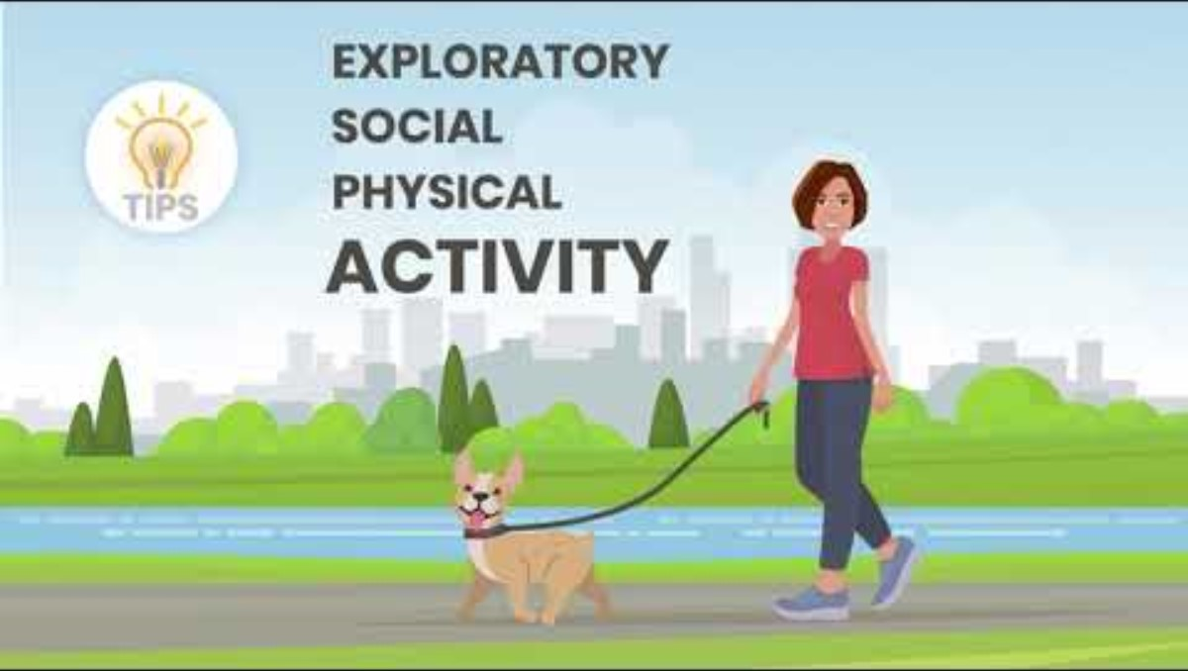
https://www.youtube.com/watch?v=fYoh3f5A2sw

Slide 35
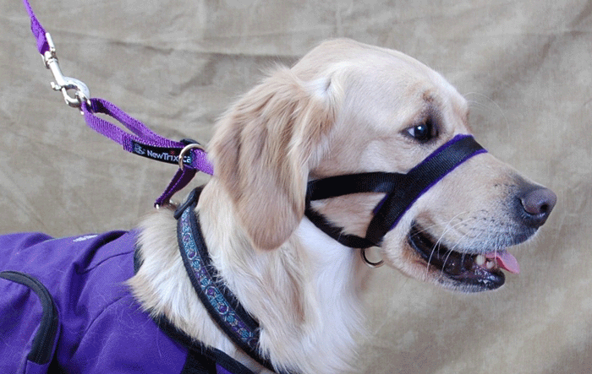
Explain how this harness should sit:

Slide 36
In shelter:
How to use a Slip Lead- with Steve from Pack Leader Dogs
  Sometimes no “stopper”
  We don’t walk dogs on the right – “heel” is left, as is the Australian way
This is used unless a behaviourist identifies a need for an alternate piece of equipment

Slide 37
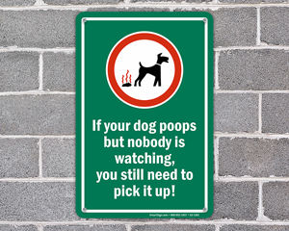
On the walk

Slide 38
Post-exercise
Quick health check
Not too over-exerted?
Grass seeds
General FAS score

Slide 39
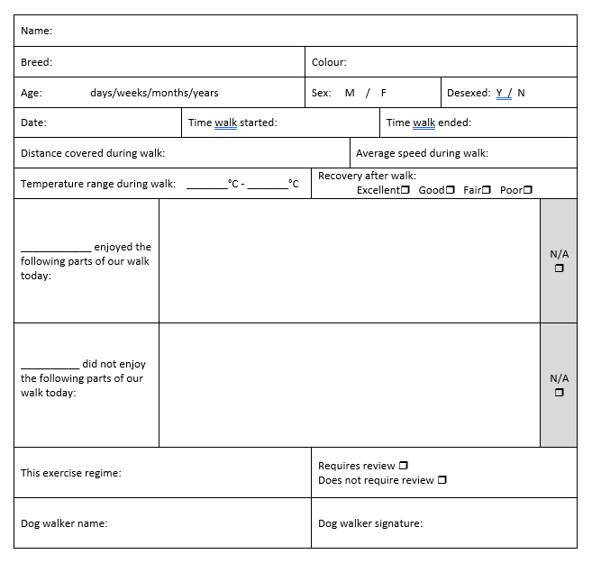
Post-exercise
Log the specifics!

Slide 40
Post-exercise
Handy hygiene
Clean, sanitise, and store the equipment used

